Slide 1

32 Locust Road
Community Preservation Committee
January 23, 2025
Notes:
I would like to briefly explain how the proposed amendment would work and why it is being recommended.

Slide 2
32 Locust Road
3.78 acres
600 feet on Cedar Pond
Joint purchase:
Open Space
Housing Trust
Contiguous with Town open space
Public sewers available for housing
Notes:
First, let’s spend a minute on the context in which we are planning.
Orleans is a traditional seaside community. It has historic character and charm. Residents like this.
Orleans is also a market town, a lower Cape business hub, secondary to Barnstable but important.
A review of what exists today indicates limited recent investment in the downtown. The value of commercial properties has not kept pace with that of single family homes.
Finally, residents and groups have expressed a desire to improve the vitality of the downtown, with the Village Center as the main focus.

Slide 3
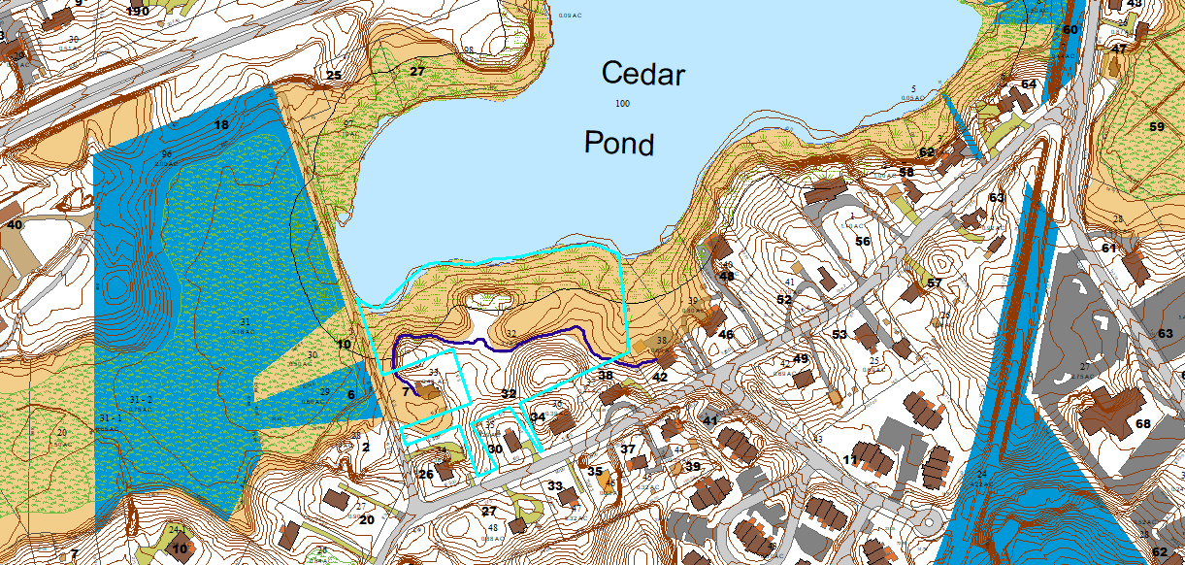

Slide 4
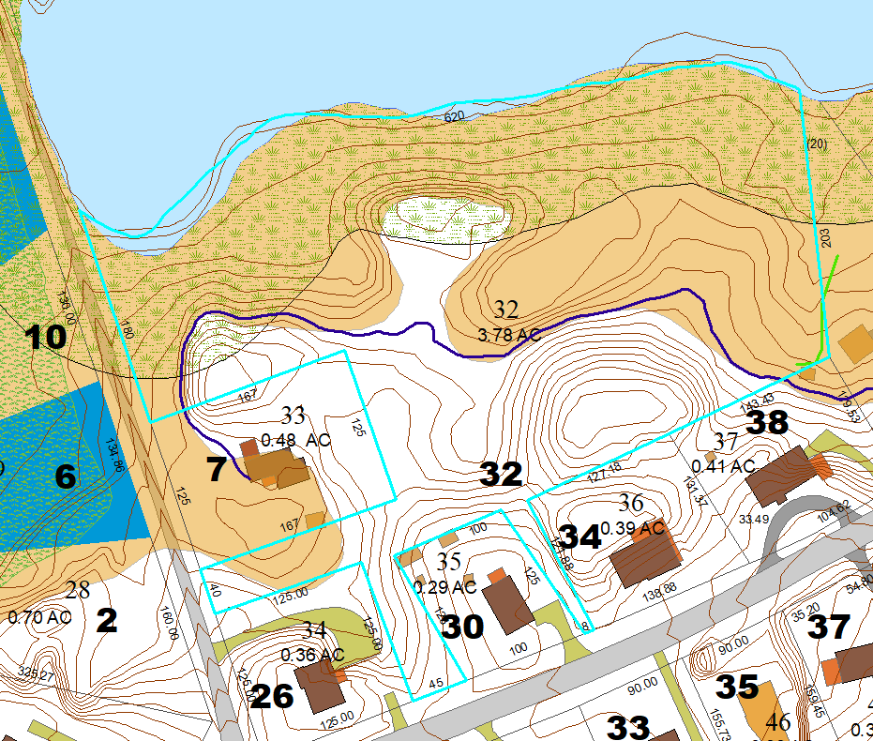

Slide 5
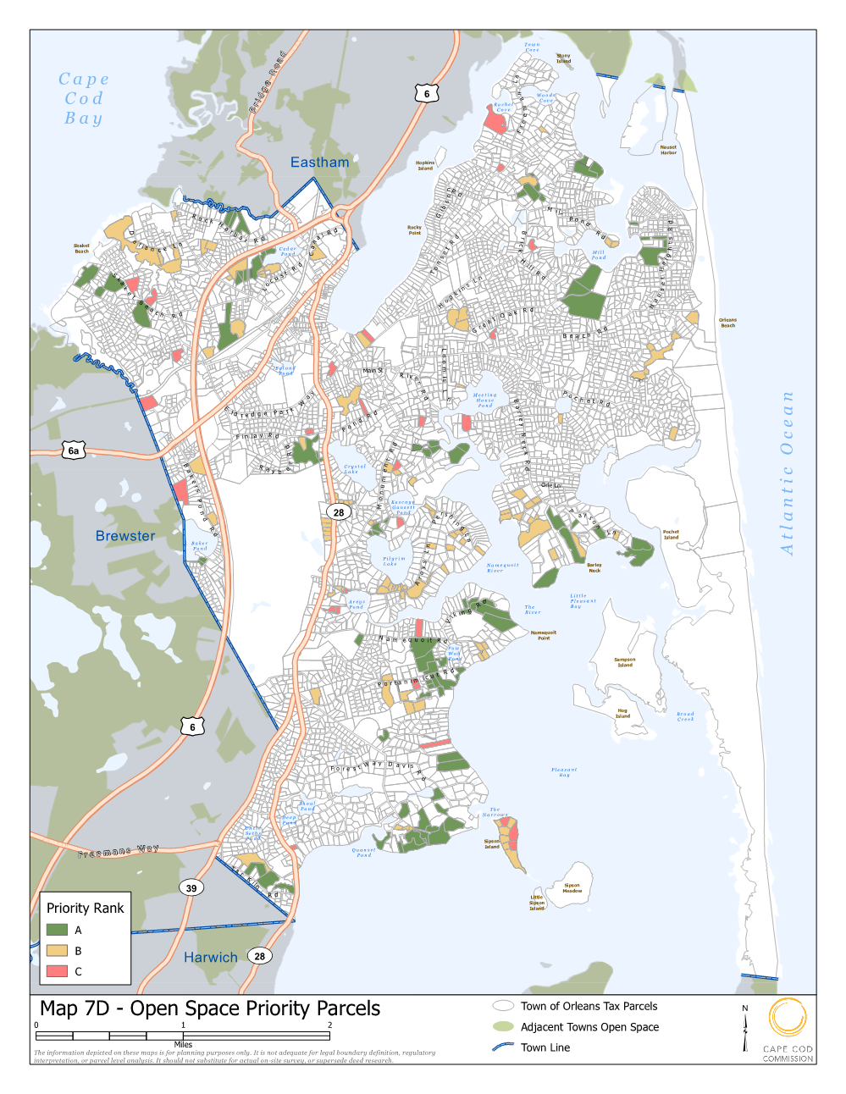
Notes:
The subject area of the zoning proposal concerns only the downtown business districts.
In the slide, the Village Center is shown in orange
The General Business Districts are dark blue, they include Skaket Corners and Cranberry Cove plazas
The lighter blue areas are Limited Business Districts in which retail and restaurant uses require a SP.

Slide 6
32 Locust Road - Benefits
Joint Purchase for open space and affordable housing development.
Shoreline area would become conservation property
Approx. 2 acres of upland would be used as a housing site

Slide 7
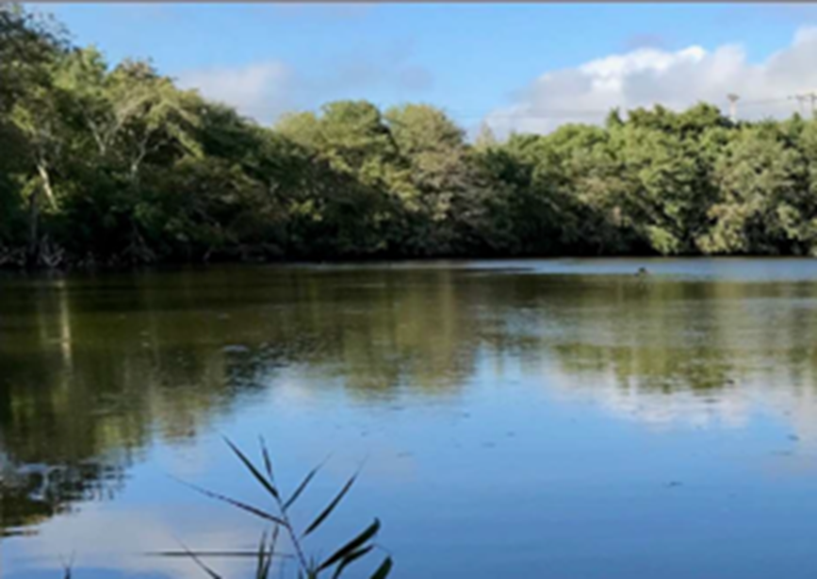
32 Locust Road – Cedar Pond
ACEC
Water quality focus
Atlantic White Cedar Swamp
Historic herring run

Slide 8
32 Locust Road – Benefits
Waterfront property
Contiguous to Conservation Land
Public access to Cedar Pond
Preserve land within an Area of Critical Environmental Concern
Priority Parcels Map in the Conservation, Recreation & Open Space Plan
Upland would be a site for workforce housing
Public Sewer eliminates future on-site disposal

Slide 9
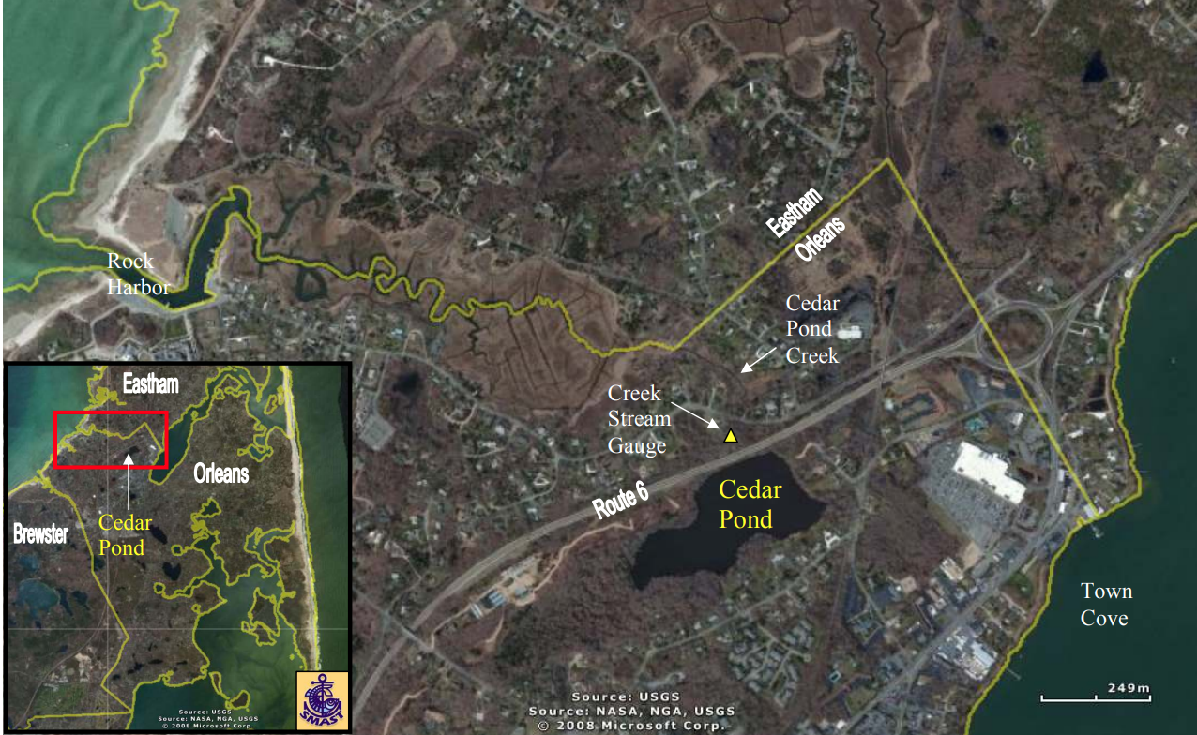
32 Locust Road

Slide 10
Bay Ridge Lane Parcels
3 Parcels - .89 acres
Adjacent to Ellis Pond
ACEC
Prevents development upgradient of pond

Slide 11
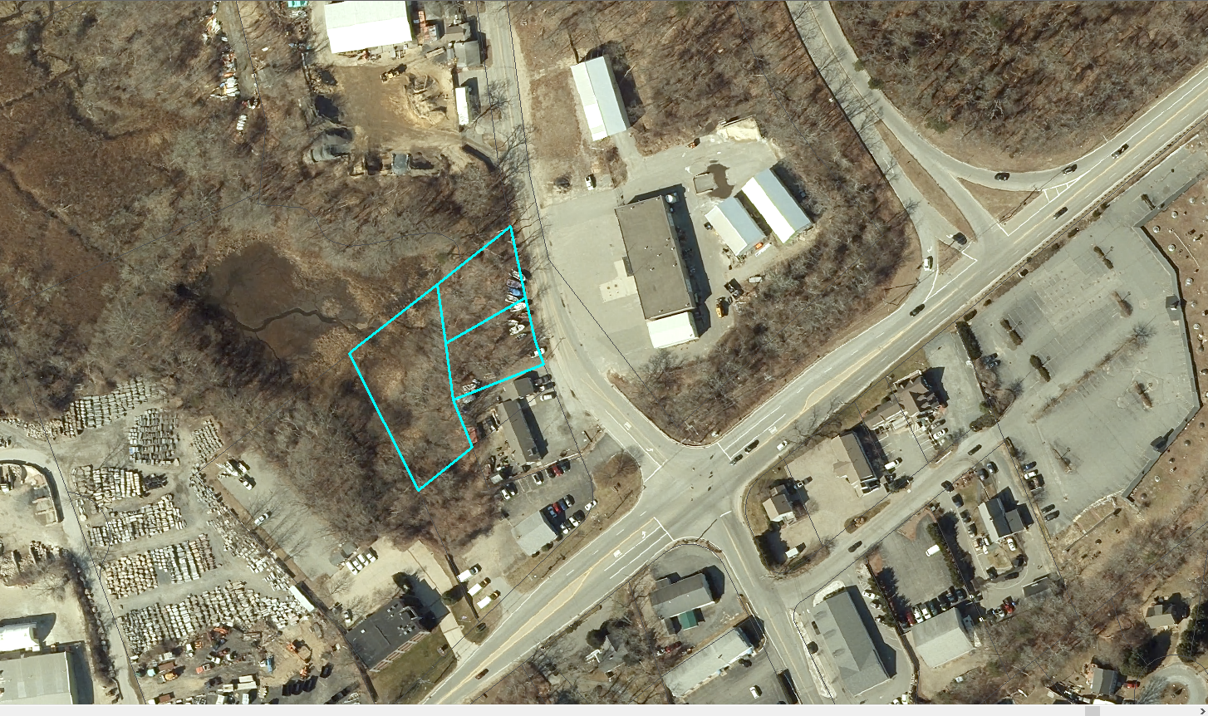
Bay Ridge Lane Parcels

Slide 12
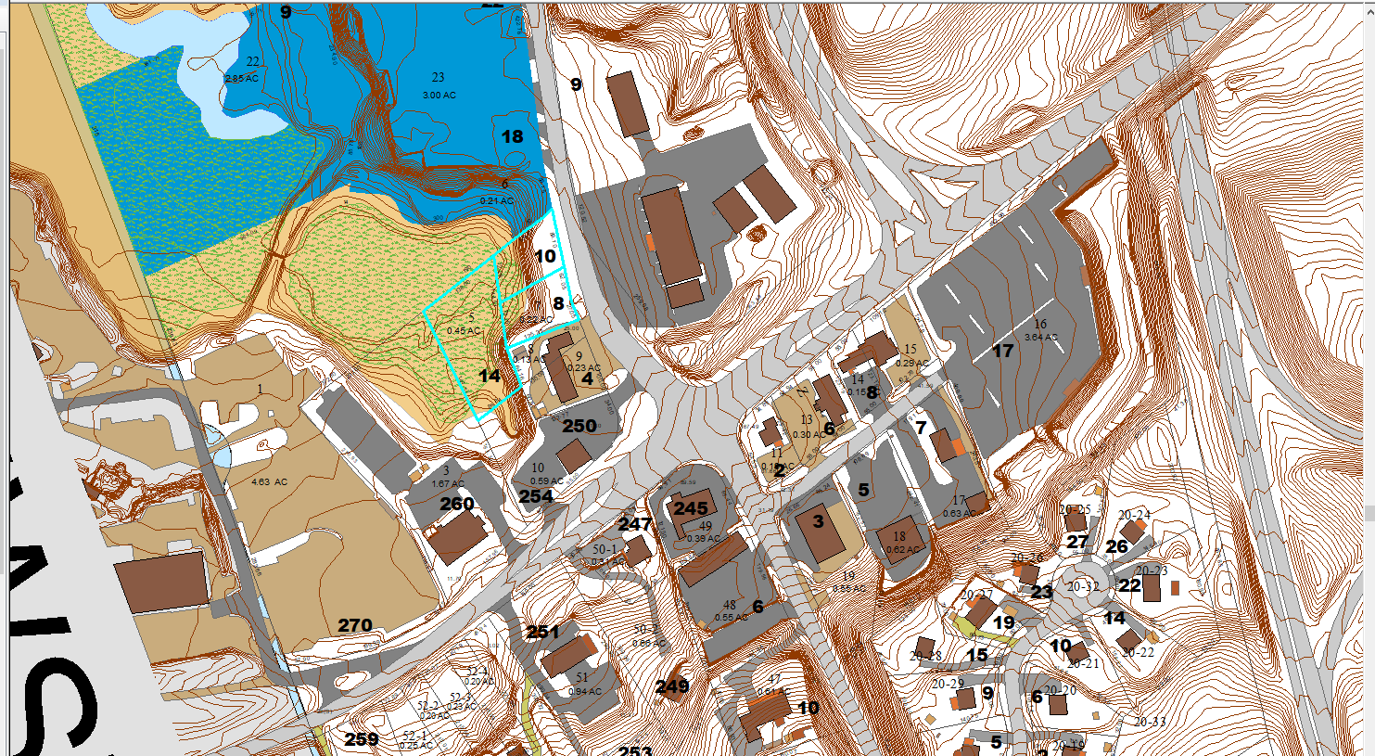
Bay Ridge Lane Parcels

Slide 13
Bay Ridge Lane - Benefits
Preserving property as a natural buffer is in the public interest
Preserves 3 parcels of mixed upland/ wetland
Headwaters of Namskaket Marsh
Within Cape Cod Bay ACEC
Cost-effective acquisition
Abuts former Highway Garage

Slide 14
Bay Ridge Lane - Cost
Owner seeking Assessed Value - $171,600
Town offered $90,000
Project on market
Informal agreement at $120,000
Limited development potential
Last use was outdoor display of boats

Slide 15
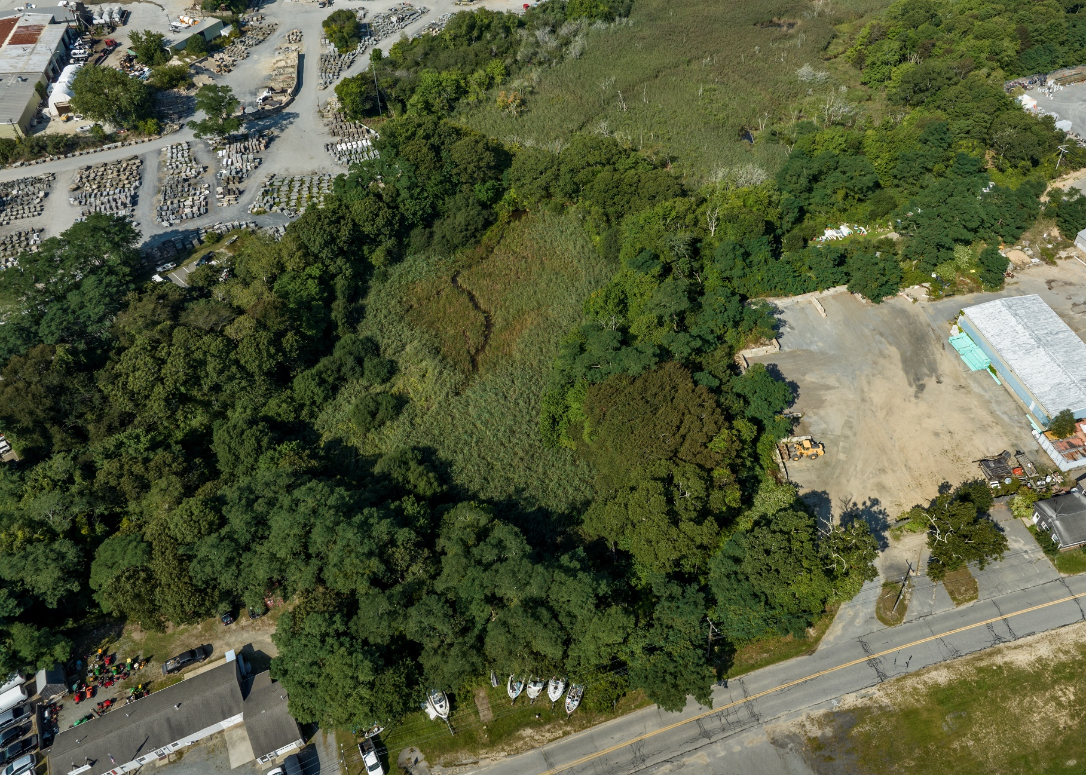
Bay Ridge Lane Parcels

