Slide 1

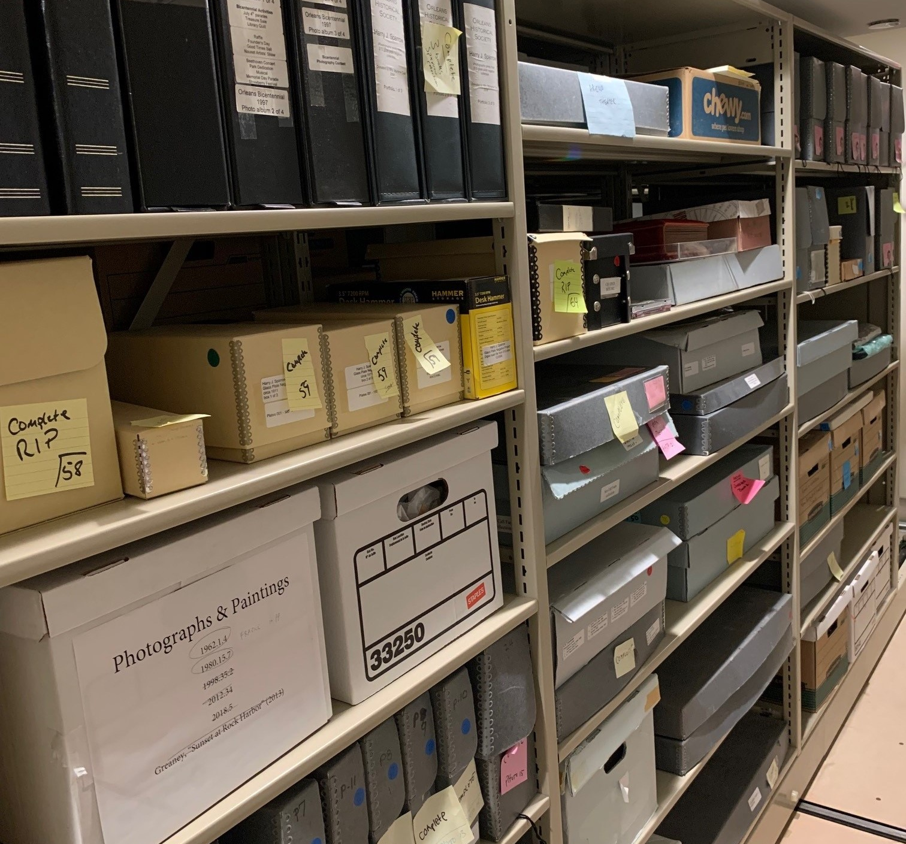
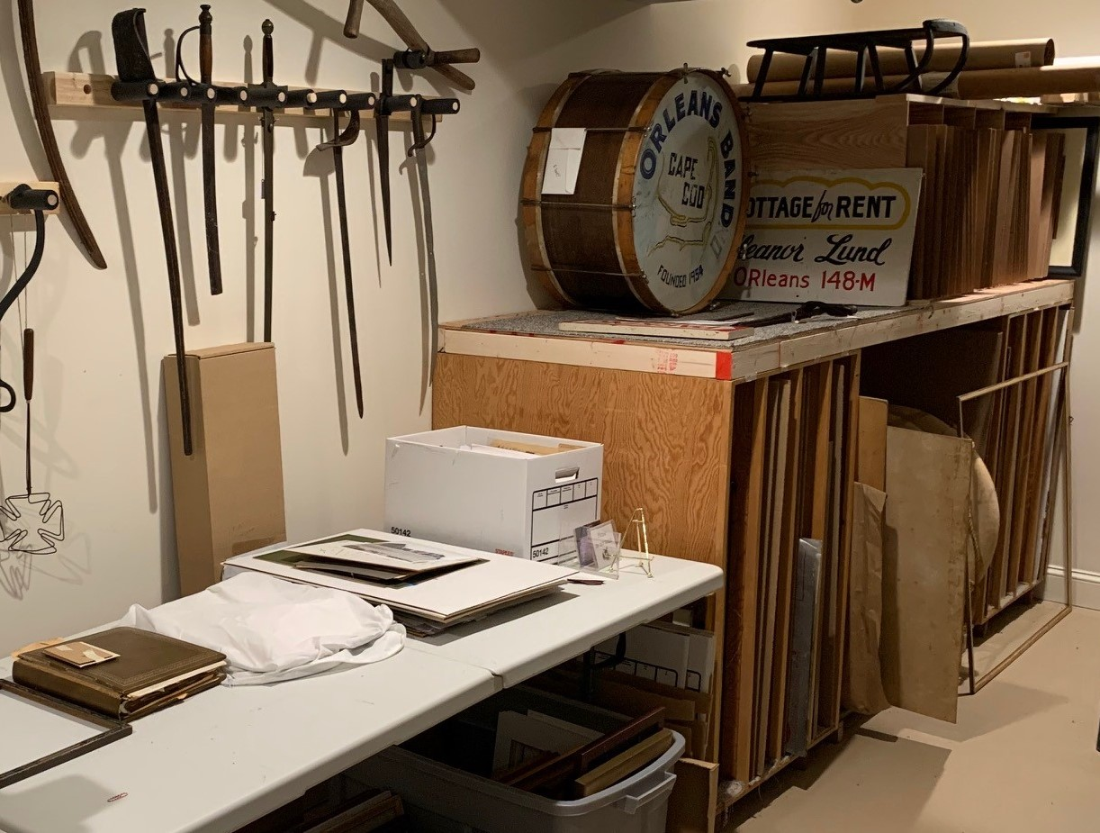
Continuing the Historic Collections Archive Project At The CHO
CPC - Thursday, December 11, 2025

Slide 2
Overview:
  $50,000 request to continue archiving 6,000+ Orleans historical items
  CHO has been important repository of Orleans archives since 1958
  Collection moved multiple times during restoration projects
  Now, most of collection is safely relocated to Hurd Chapel
  Remaining items need to be catalogued
  Must prepare for imminent new collections (e.g., Sea Call Farm)
  This Grant Will:
  Enable CHO to complete the work already started
  Provide expansion capability for anticipated new large archives
  Help the CHO move toward making collections searchable online

Slide 3
Accomplishments To-Date:
  2021 “SHRAB” state grant: “Roving Archivist” assessment + report
  2021 CPC $56,000 grant:
    CHO addressed nearly all SHRAB recommendations
    Collections safely moved to climate-controlled Hurd Chapel space
    Items now organized and stored in clean, stable environment
    Categorized 427 banker boxes
    Completed survey of each box to evaluate contents
    Designed and built storage racks to hold hand tools, farm implements, household tools
    Built custom storage racks for nearly 70 framed pieces
    Updated location records for over 2,600 items
    Photographed hundreds of objects and added them to database
3

Slide 4
Goals of New Grant:
  Ensure capability to find all items in the 6,000+ collection when needed
    Contents of 139 boxes and 52 books, scrapbooks, and binders still need to be inventoried, and their new locations updated
    Continue to use trained professionals to update the museum-standard lexicon, collection, and status fields of the database
  Complete current archival process; prepare for new large-volume items
  Store artifacts to professional standards to ensure their preservation
  Establish a realistic protocol for accessioning items into the database
  Better access to collections for collaborative exhibitions, easier assimilation of new collections and
  paving the way for future public access online.

Slide 5
Timeline:
  July/August 2026: Database remediation – collection, lexicon, status
  Sept. 2026 – May 2027: Complete inventory, re-housing, location data
  June 2027: Finalizing detailed protocol for new acquisitions
Cost (professional labor, archival materials):
Task | Cost
Database remediation, etc. | $ 5,200
Complete current inventory, prepare for new | 40,150
Create, train on protocol | 1,000
Re-housing of new items | 3,650
Total | $ 50,000

