Slide 1
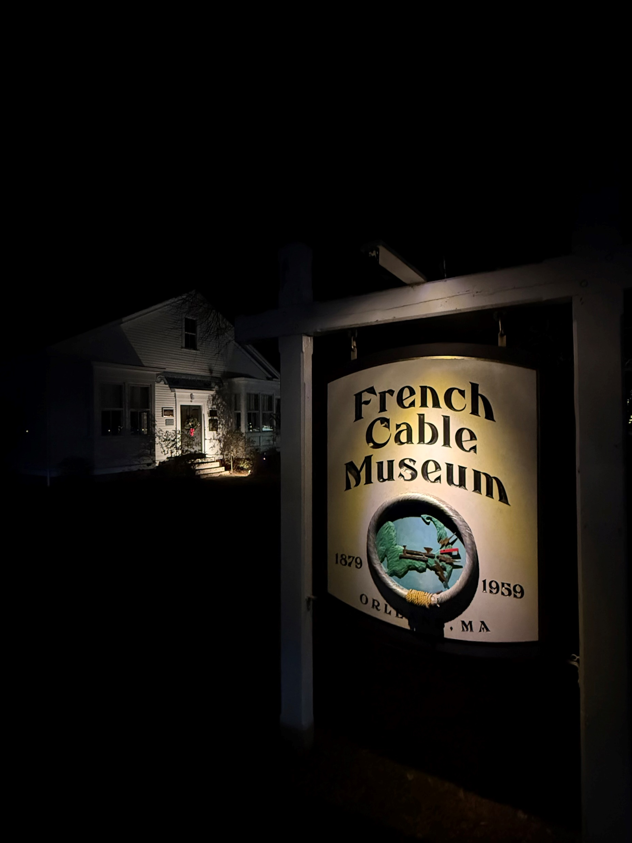
French Cable Station Museum
1972 - Listed on National Register of Historic Places
2017 - IEEE Milestone Award

Slide 2
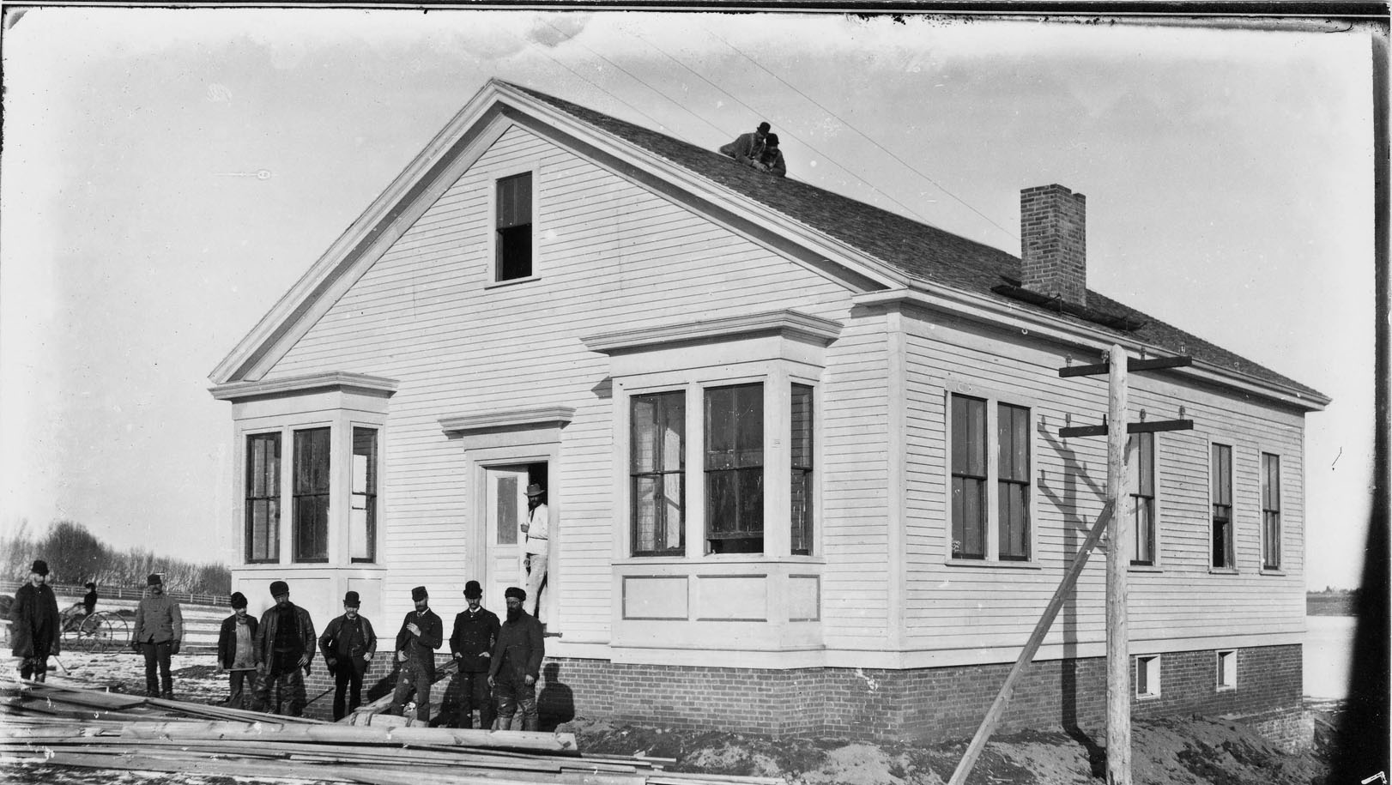
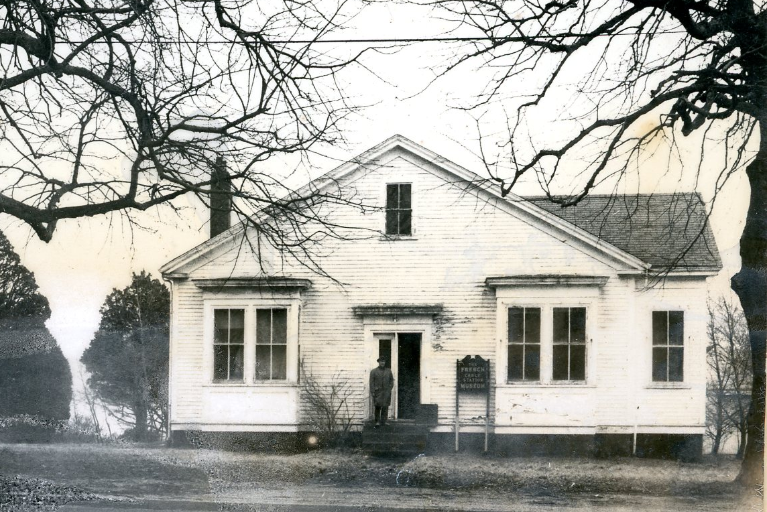
New French Cable Station Museum, 1971
Orleans Station, 1898

Slide 3
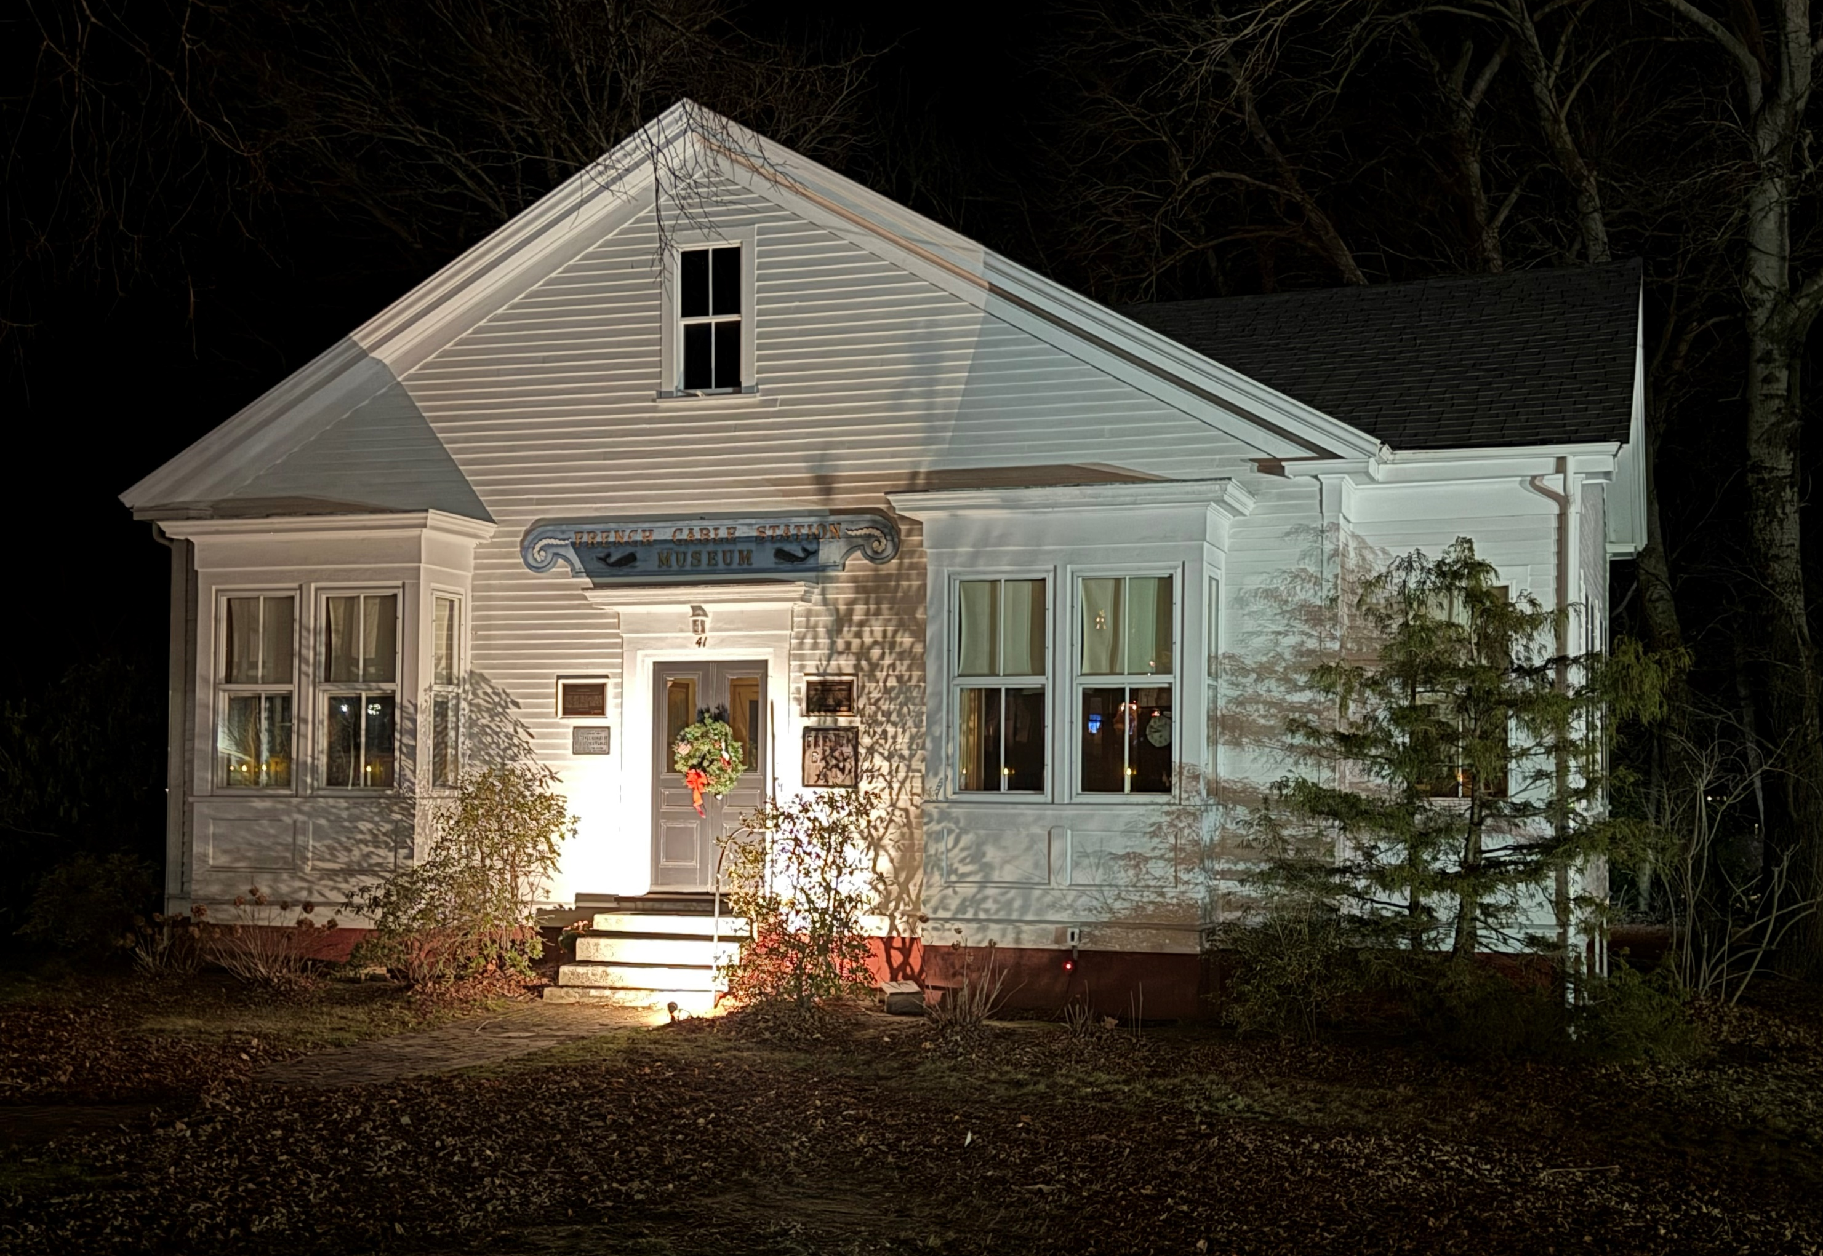
Projects
Funded through private donations, Cultural District & Community Preservation Grants
New HVAC system
Removal of environmental hazards
Restoration of windows & exterior doors
Exterior painting
New roof
Flagpole installed for OCD banner
Archive storage/library conversion
Digital database
Document archiving
Open in 2021 with COVID protocols
Enhanced exhibits

Slide 4
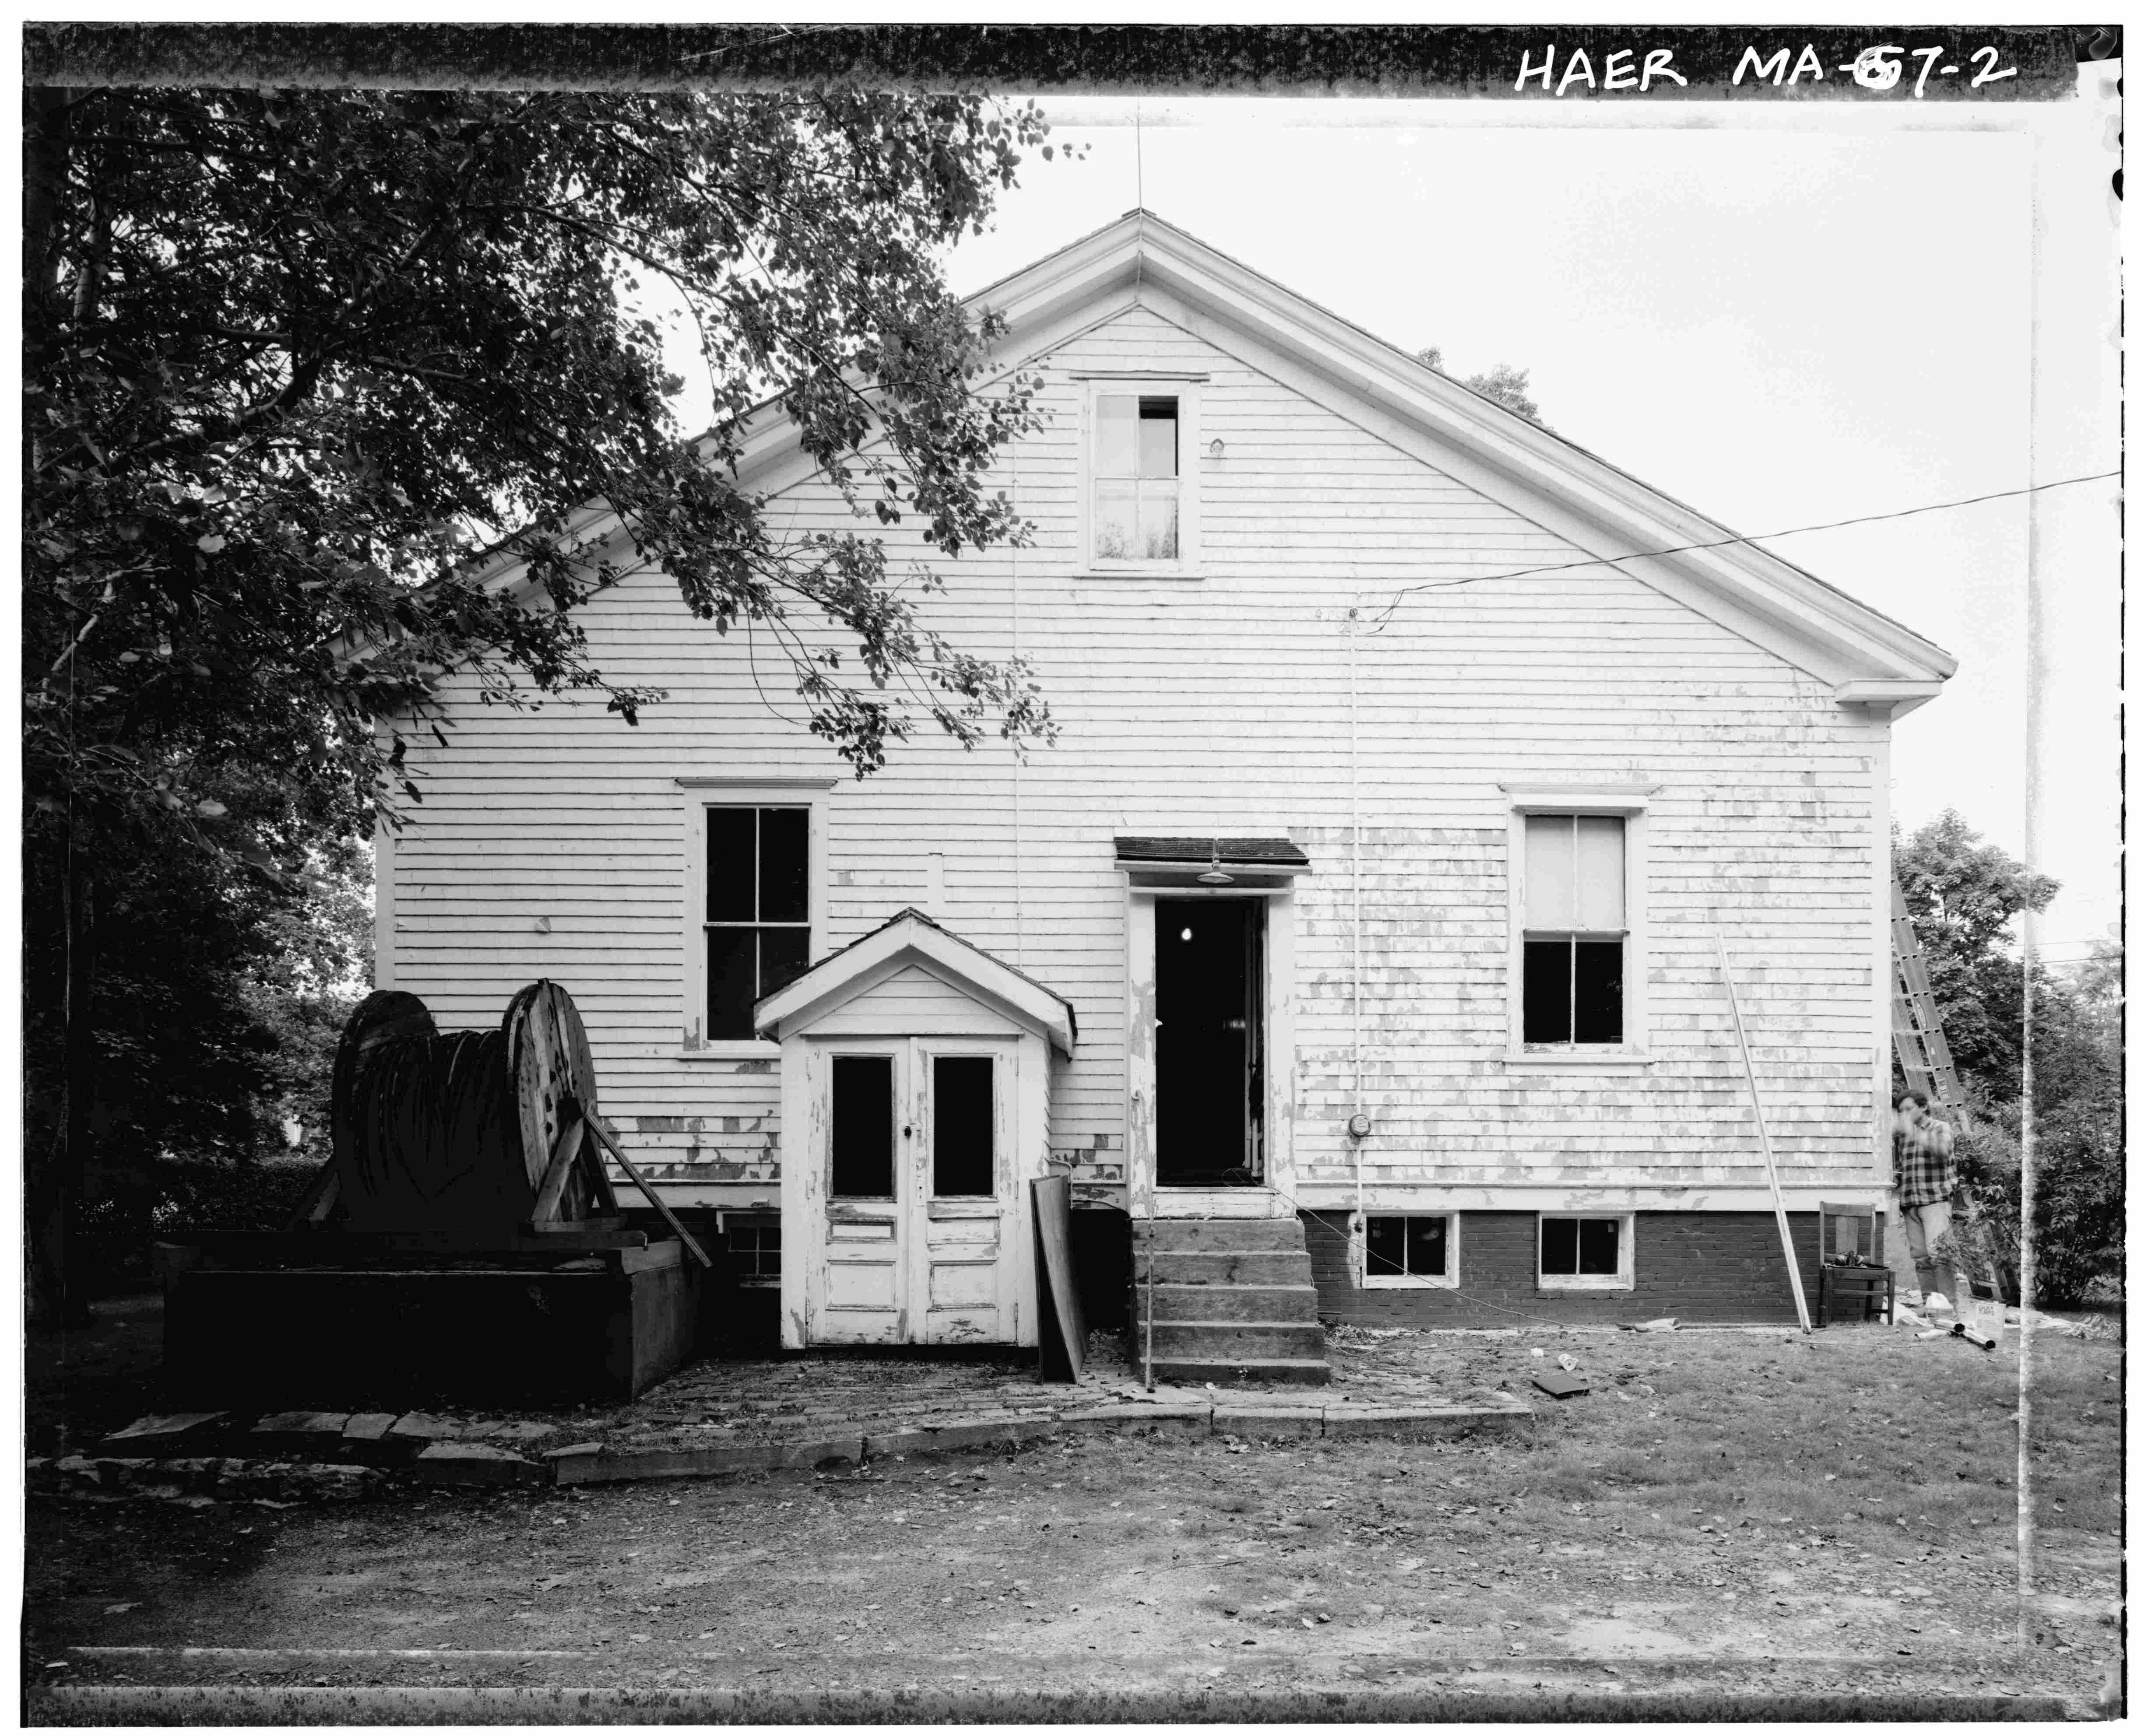
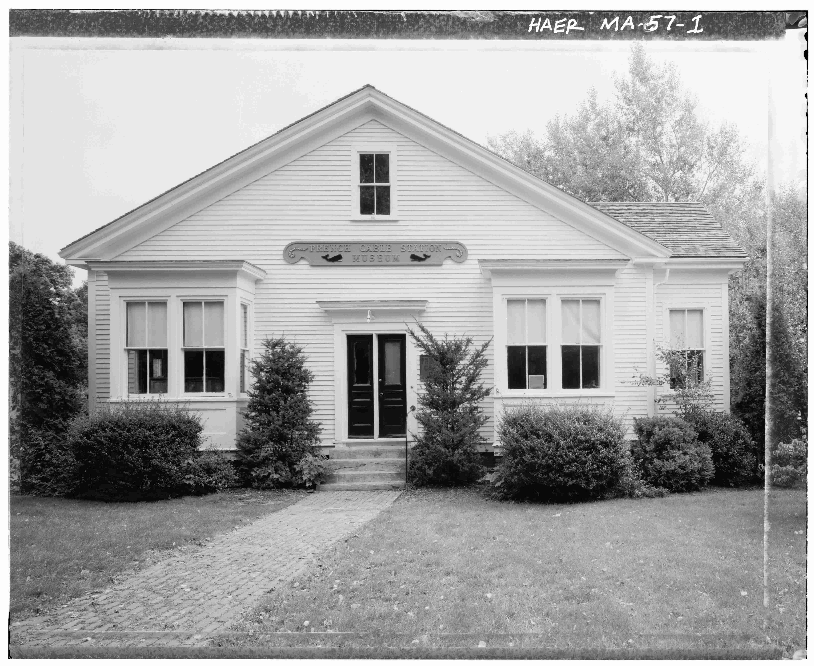
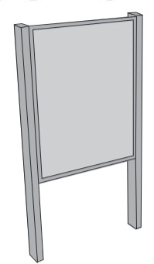
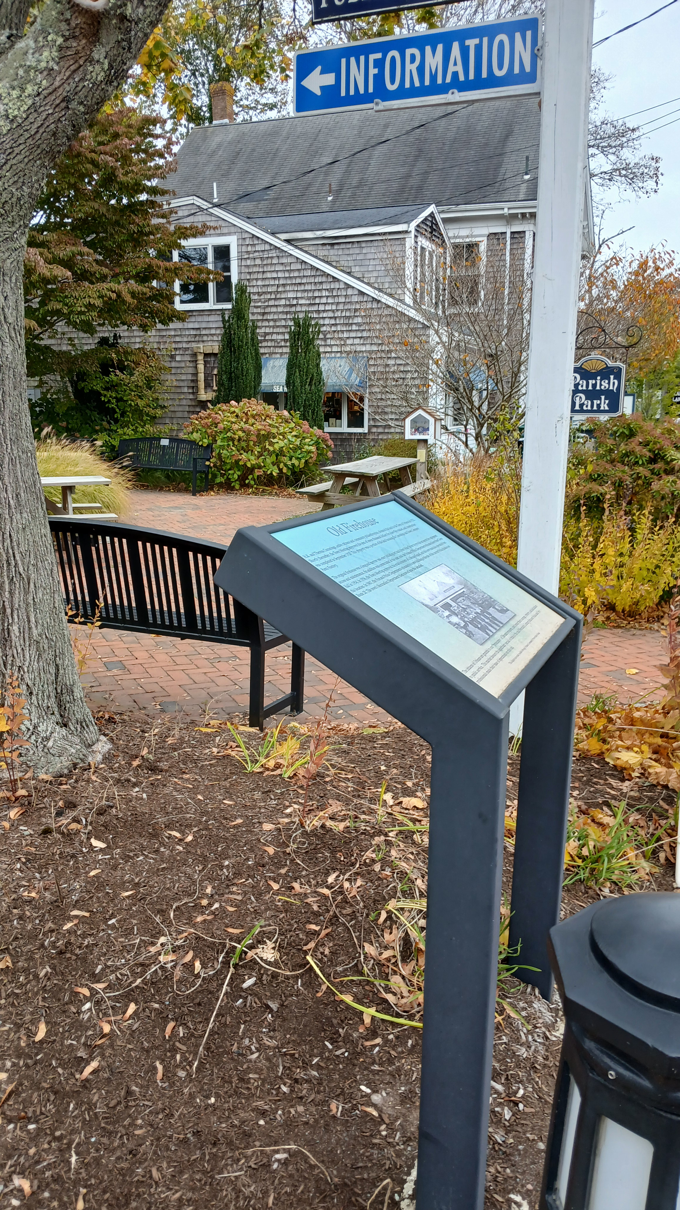
Interpretive Signs
24” x 36”
Front of the building – facing 6A
Rear of the building – parking area used by OYC & Addison Gallery
24” x 18”

Slide 5
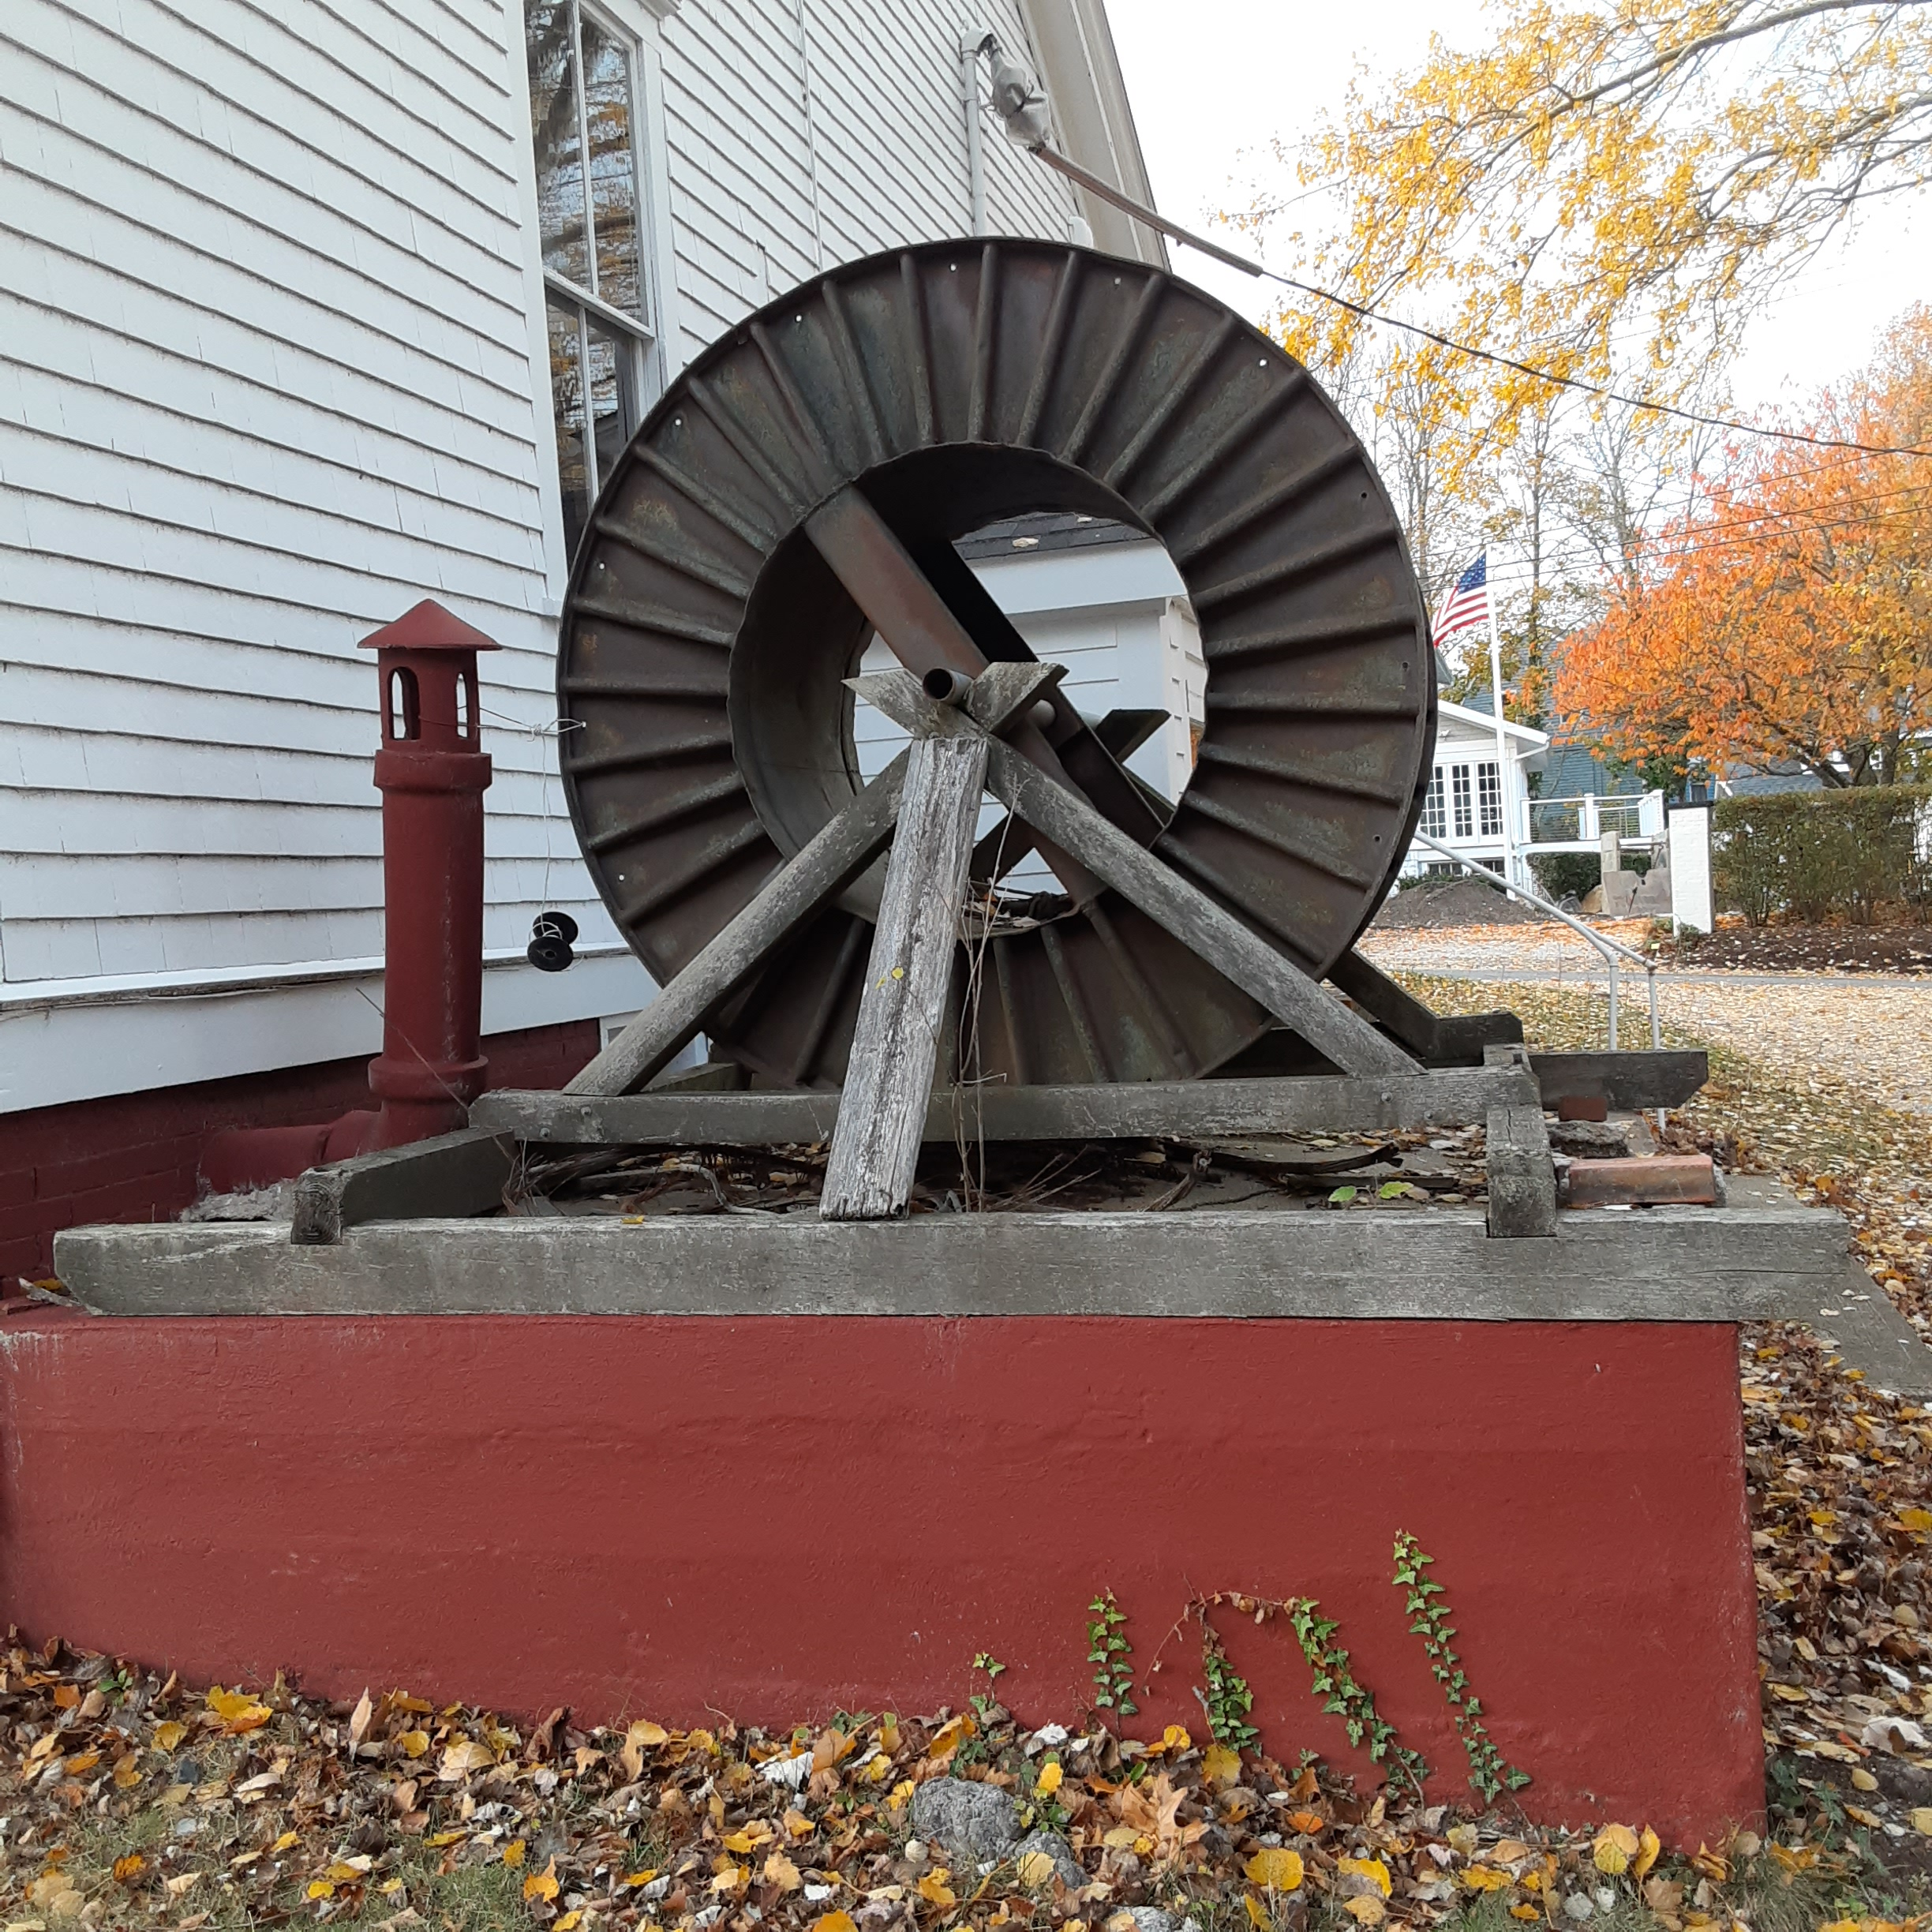
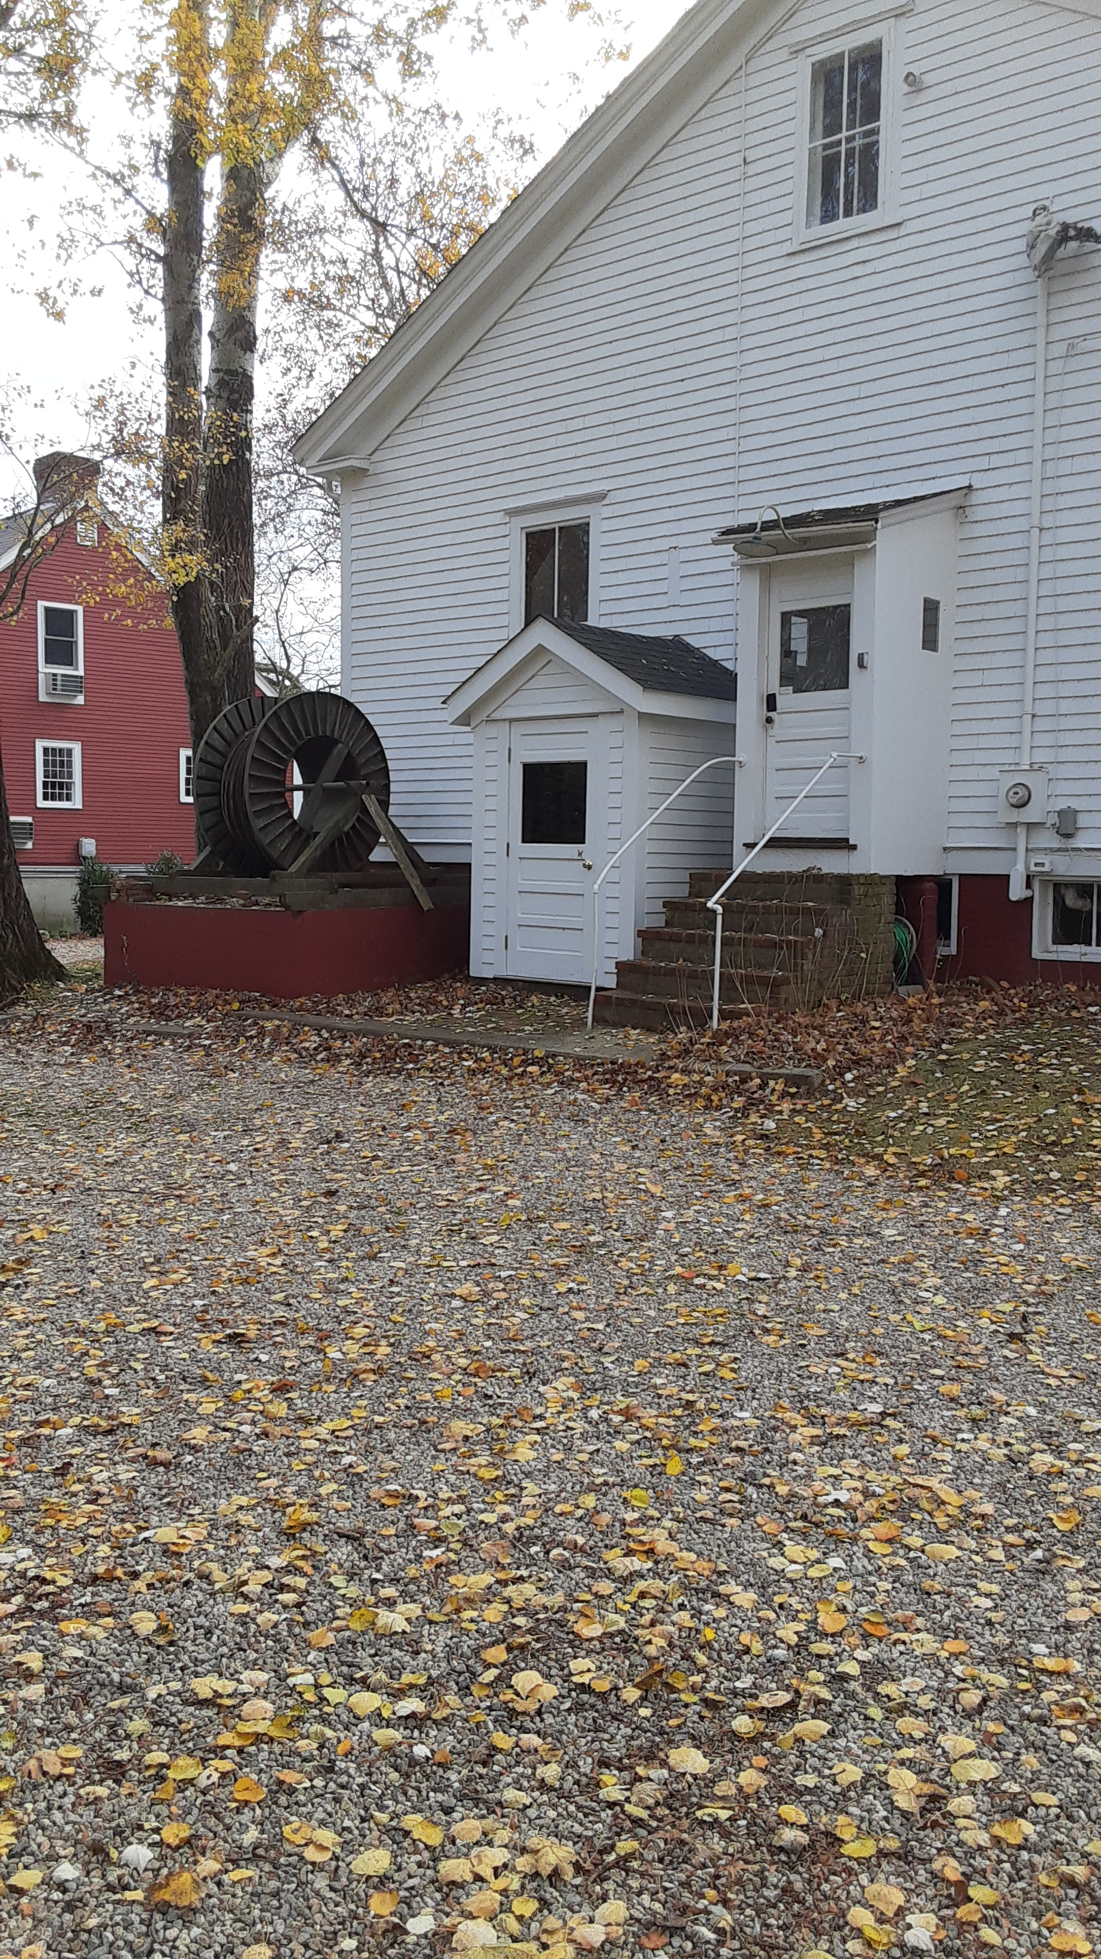
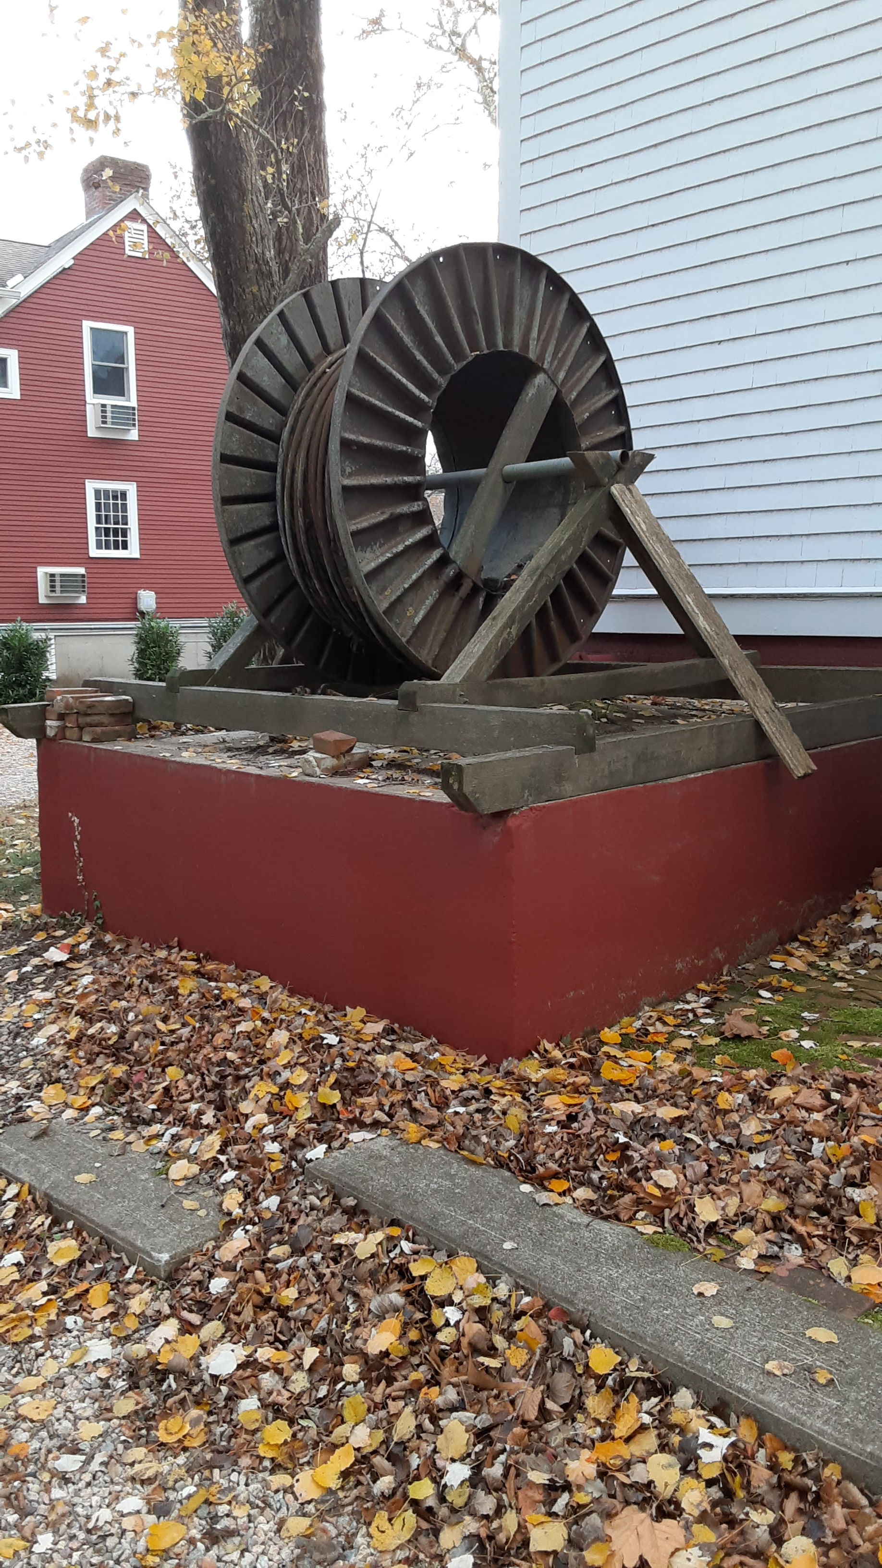
Telegraph Cable Reel
This was the cable used for repairing the breaks in Town Cove.
Restored in the 1990’s, it is in need of restoration again.

Slide 6
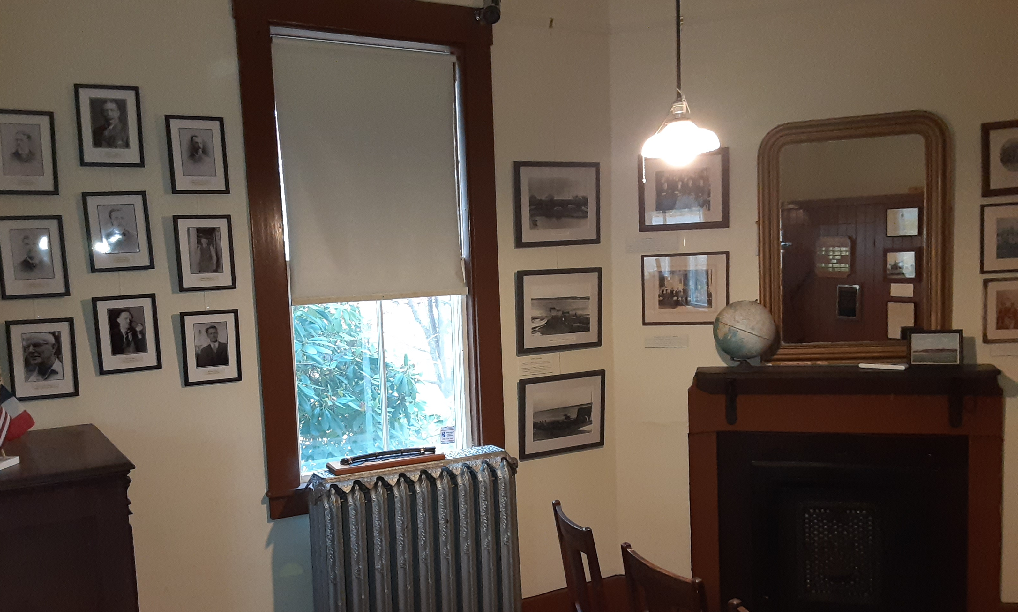
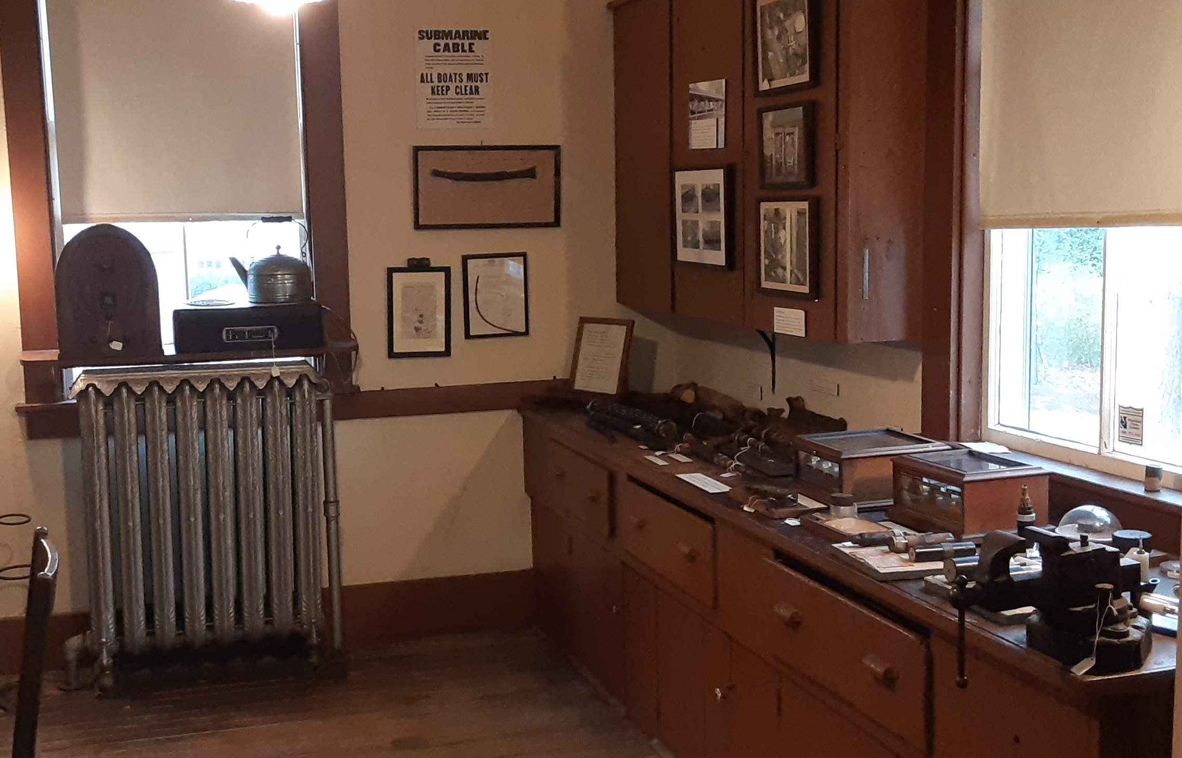
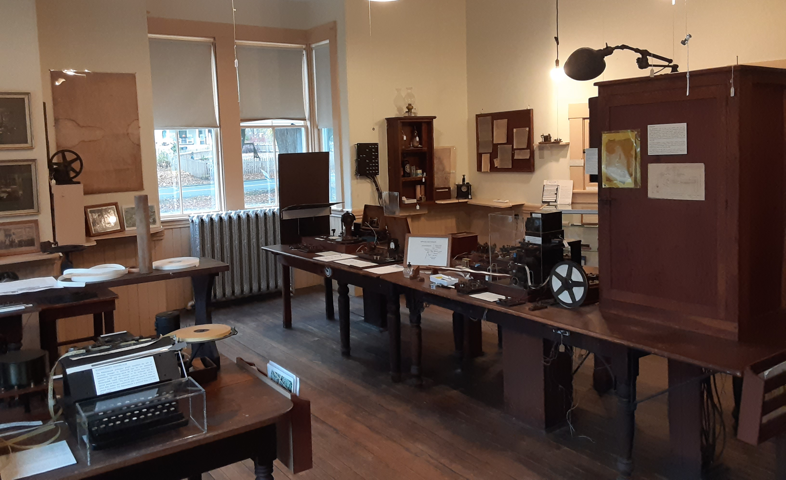
Interior Displays
Signage created to explain the equipment
Photos added where appropriate
Signs and framed photos designed to compliment the antique workspaces
Superintendent’s Office
Test Room
Operator’s Room

Slide 7
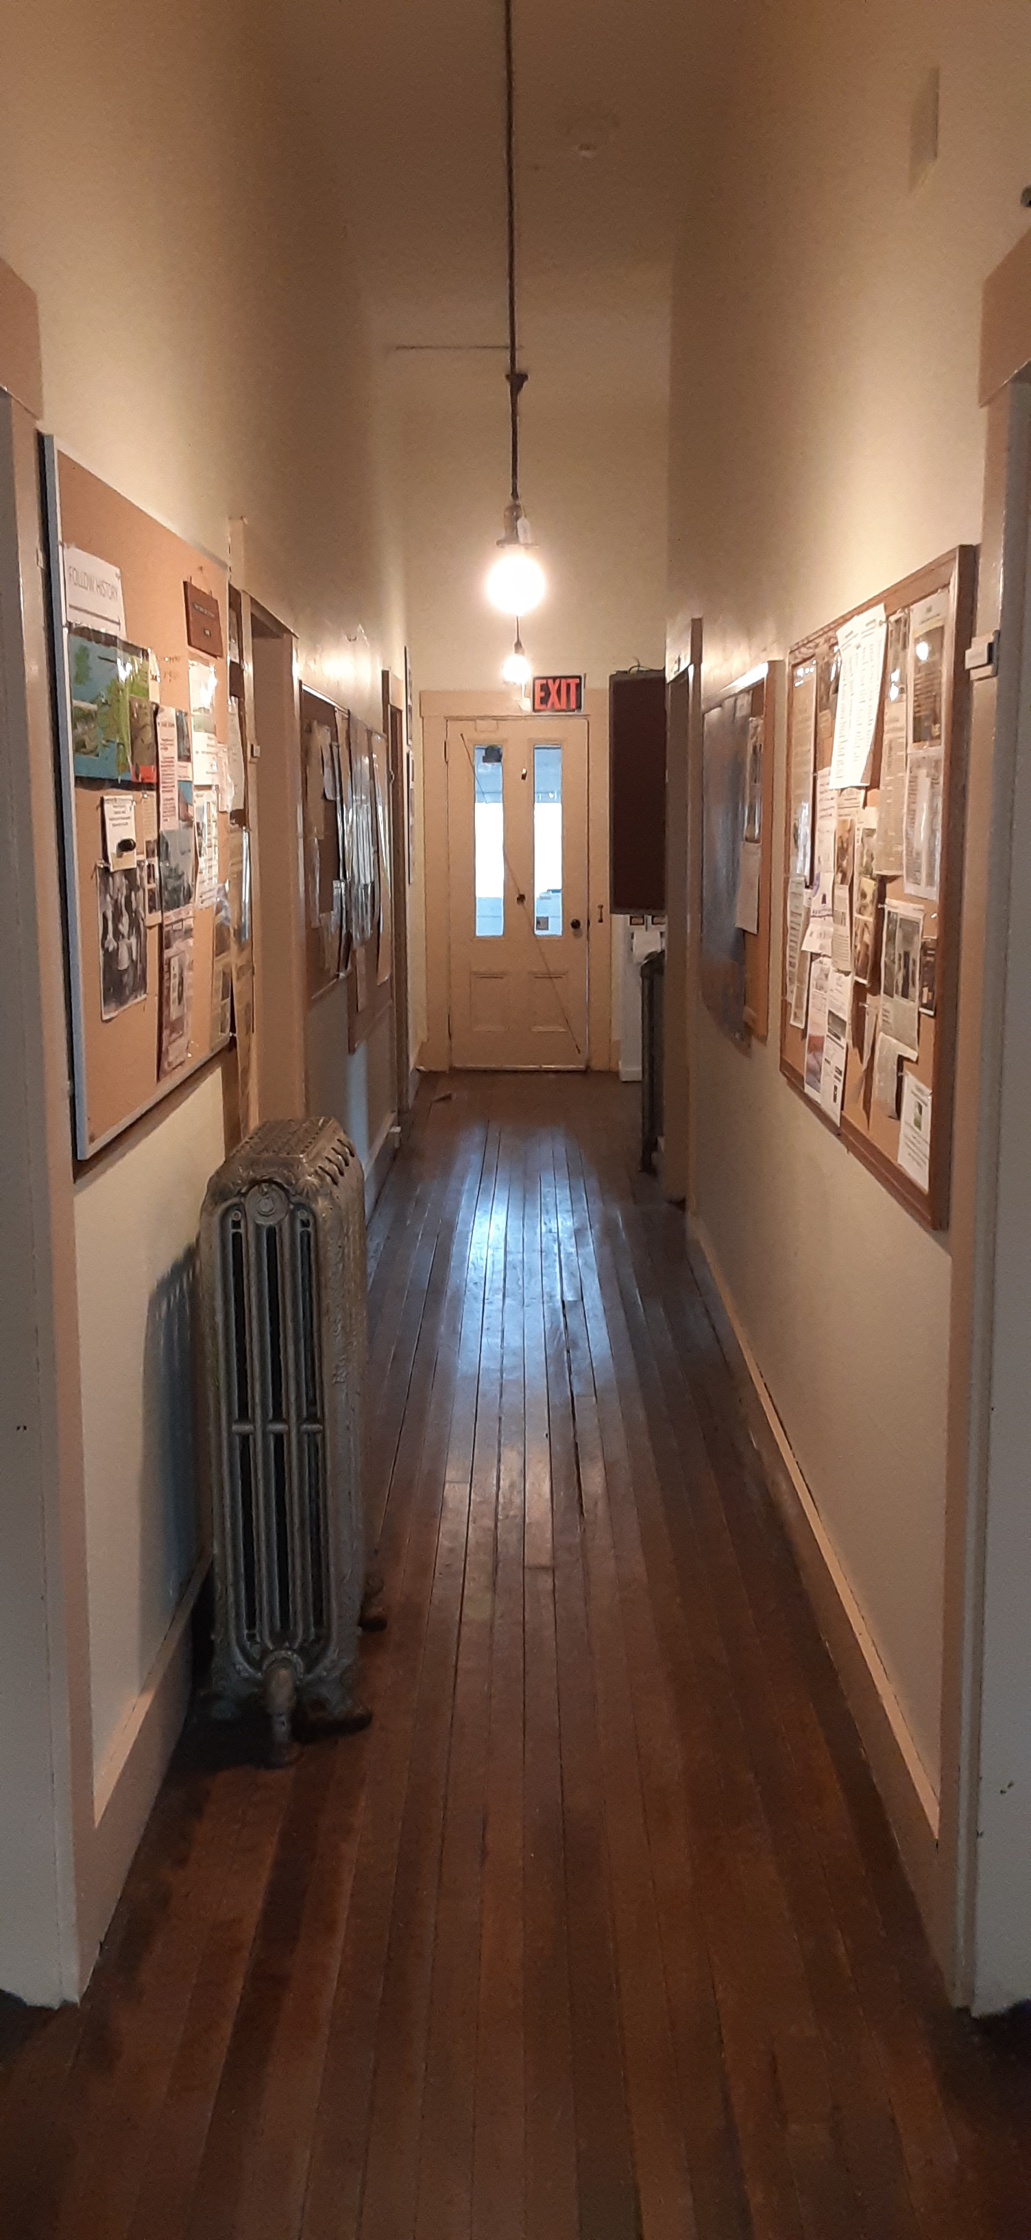
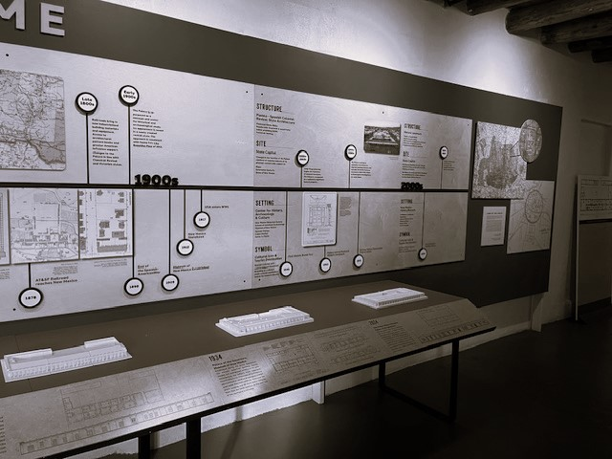
Main Hallway
The only appropriate place for an overview of telegraph history
No interference with station operations layout
Proposed Concept
Timeline style
Current local historical happenings
Highlights from the archives
Santa Fe, New Mexico

Slide 8
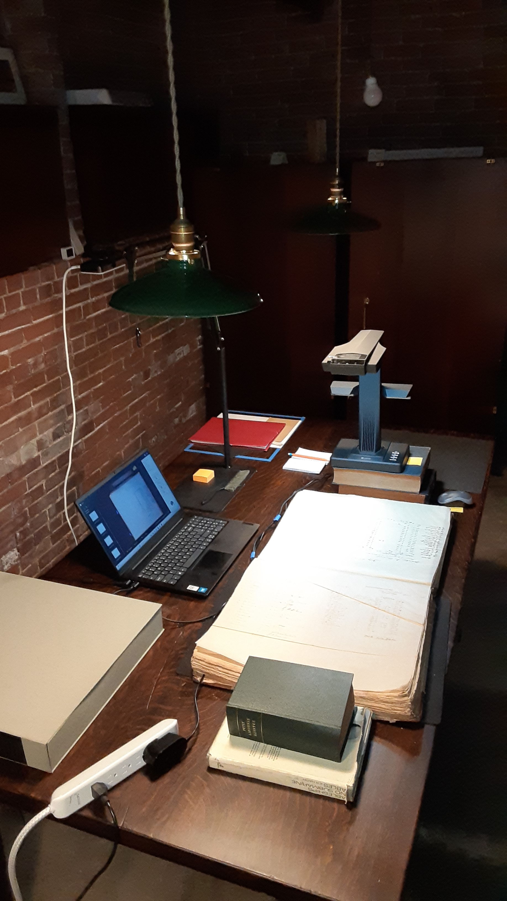
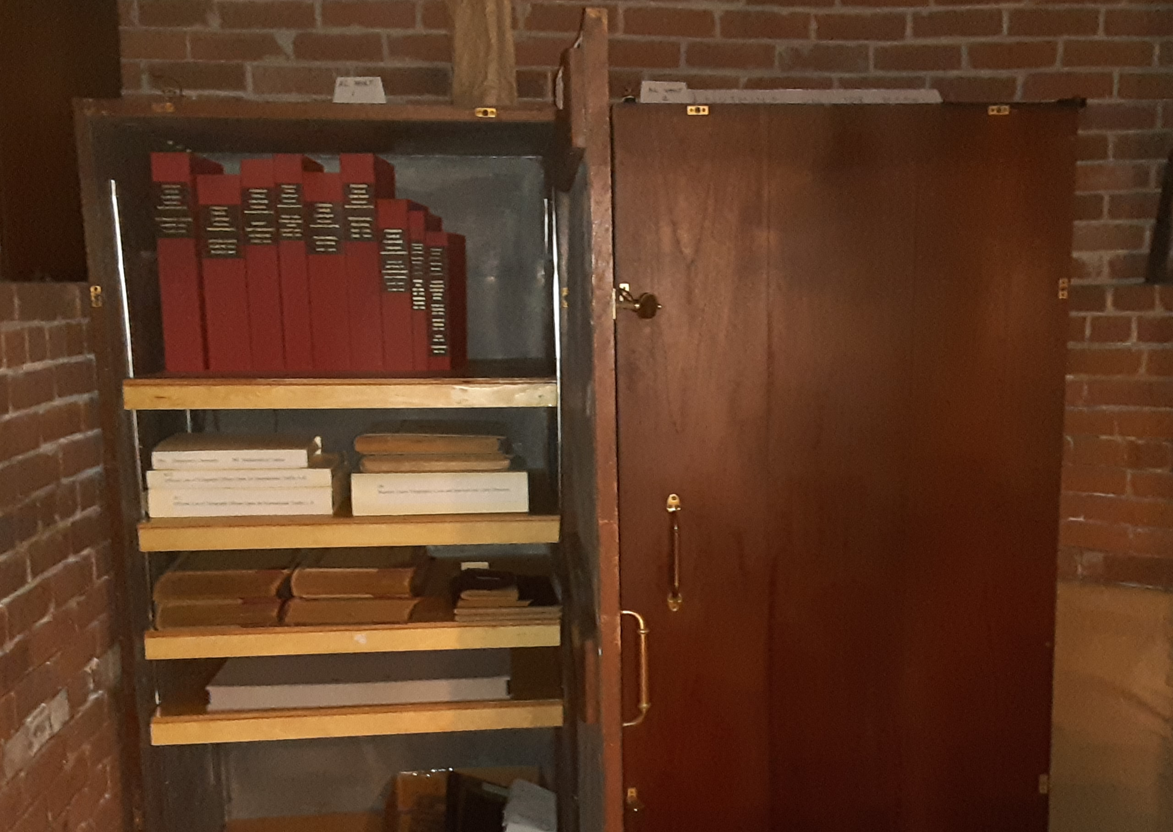
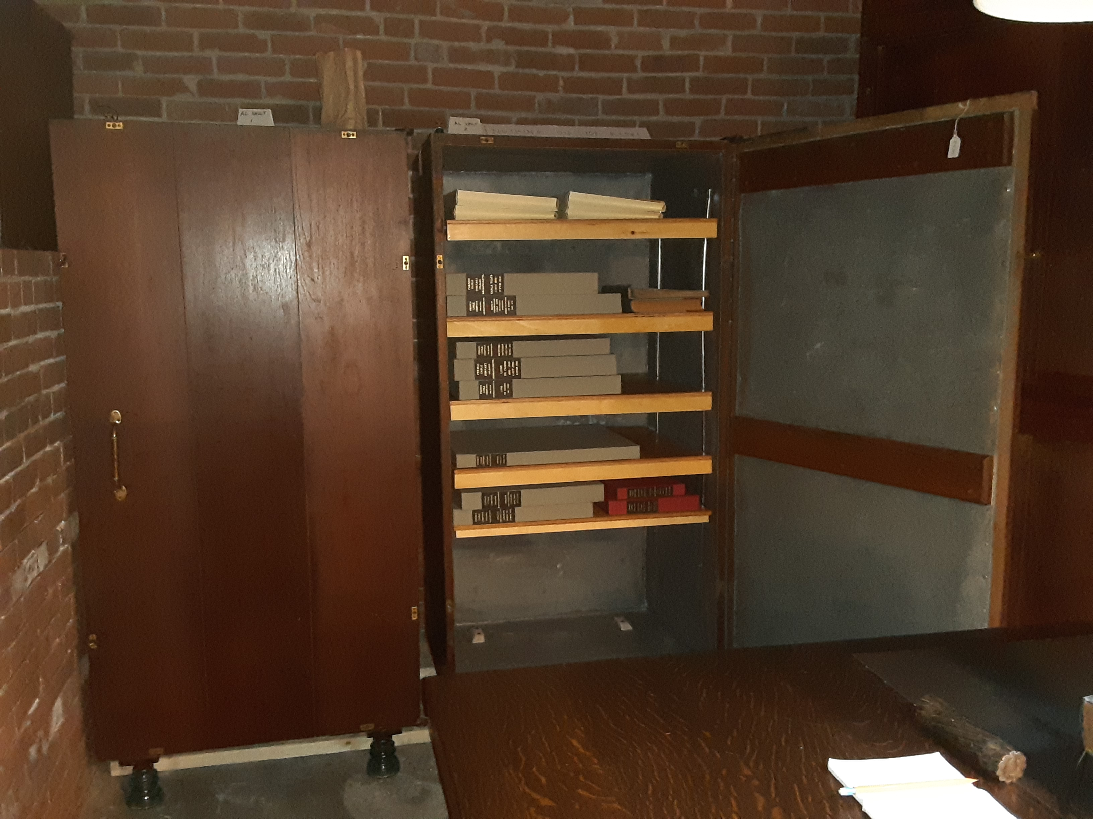
Transcription of Digitized Documents
Over 3000 pages from 1890’s-1950 are currently scanned including:
Letters from superintendents to managers in N.Y.
Personnel records
Log books for operator message errors
Data on repairs to the cable
Inventories and expense journals

Slide 9
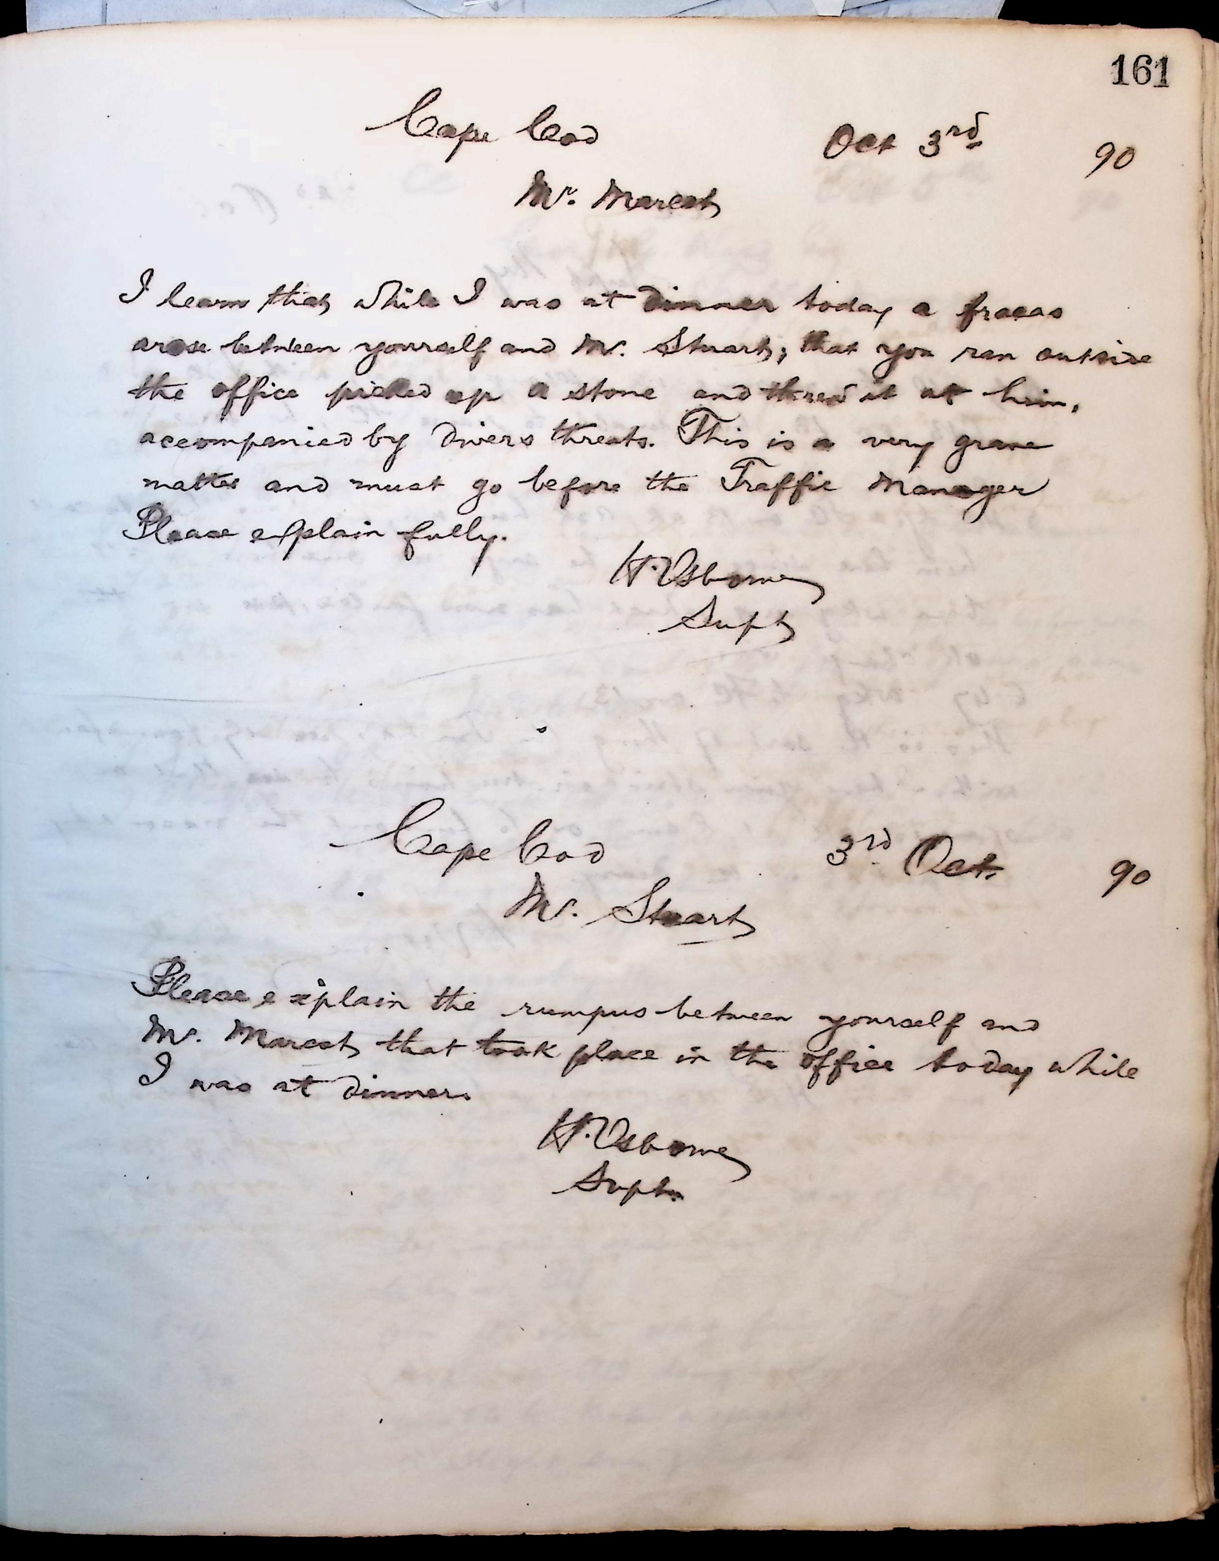
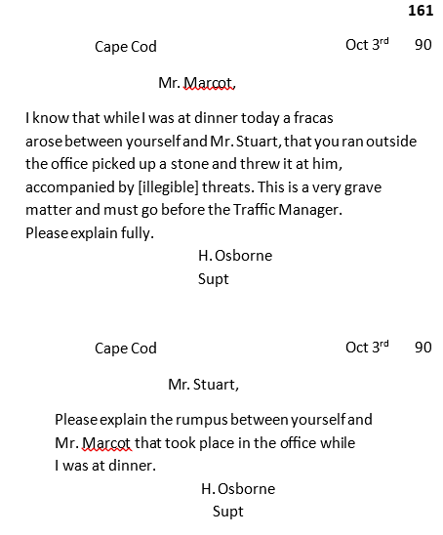
Crowdsourced Transcription
Added Benefits:
Builds community – locally and beyond
Engages volunteer’s interest in history and technology
Provides another way for visitors to discover Orleans
Success Stories:
National Archives- over 2,000,000 pages
Library of Congress – 780,000 pages
Historical Society of Cheshire County

Slide 10
Fiscal Year 2027
Community Preservation Grant Proposal
Educational/Interpretive Signage $3,925.00
Telegraph Cable Reel Restoration $1,800.00
Interior Display $4,355.00
Transcription of Digitized Documents $5,900.00
Total Requested $15,980.00

